Slide 1
Understanding Photographs:
Introduction to
Archival Principles and Practices
Cushing Memorial Library and Archives
Texas A&M University

Slide 2
Welcome!
Instructors
Logistics
Notes:
A&M Consolidated School, Agricultural and Mechanical College, Texas, [between 1900 and 1920(?)], unidentified photographer, Library of Congress Prints and Photographs Division, 96515543
Hand out caption list & explain use of photos.
Thanks to host
General housekeeping: tours, lunch, restrooms, turn off cells.
Introduce self and co-instructor

Slide 3
Word on reference sources
Photographs: Archival Care and Management (PACM), 2006
A Glossary of Archival and Records Terminology, 2005, http://www.archivists.org/glossary/index.asp
Notes:
Workshop based on book.
Glossary 2005 SAA publication available online (click on Resources)
Binder contents and handouts, including additional resource bibliography list

Slide 4
Workshop modules
Day 1 | Day 2
1. Reading & researching | 5. Accessioning & arrangement
2. Handling & identification | 6. Description & cataloging
3. Preservation, storage & housing | 7. Copying & digitization
4. Appraisal & acquisition | 8. Public service & outreach

Slide 5
Goals
Manage & care for photos
Use archival principles
Identify resources & techniques
Introduce standards & best practices
Learn about risks & issues
Set priorities & solve problems
Notes:
Identify specialized resources, techniques and tools available for managing photograph collections from researching unidentified photographs and identifying common photo processes to managing a copy service;
Learn about risks and concerns specifically related to photographs from inherent vice of nitrate and acetate based films to legal and ethical issues;
Identify and follow standards and best practices when working with photographs;
Set priorities and make informed choices in your photograph management strategy.
Emphasize that this is a basic issues designed to touch on highlights. To go in-depth, future advanced workshops will focus on specific issues. There is much more to cover on all eight modules, this workshop will showcase the general concepts of each topic.
You will not leave this workshop and be a:
Photo connoisseur, curator or historian; Appraiser; Digital automation specialist; Information technology specialist; Cataloging specialist; Conservator; Copyright lawyer or Ethics officer; Reference specialist

Slide 6
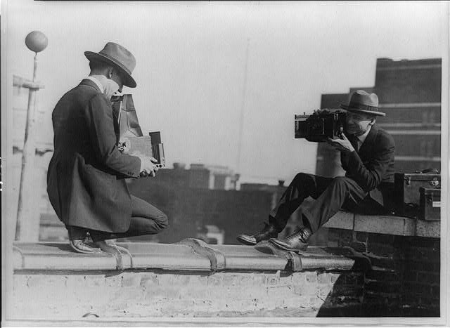
Introductions
Notes:
[Two photographers taking each others’ picture with hand-held cameras while perched on roof], [between 1909 and 1932], NPCC, LC P&P, cph3b43800
Rules of engagement: Ask questions! Participate! However, we need to stay on task Specific questions and comments can be addressed outside of teaching time Move around (be considerate too) Have fun!

Slide 7
Module 1 Reading and Researching Photographs
Visual literacy:
Glossary: The ability to decipher cultural and technological systems that express meaning using graphic images, icons, or symbols.
Notes:
Butte, Montana. Victor Rauh and one of his children reading a newspaper, 1942, Russell Lee (photographer), FSA-OWI Collection, Library of Congress Prints and Photographs Division [LC-USW3- 009704-D [P&P].
As children, we are taught how to read text but rarely is any thought given in teaching how to read pictures.

Slide 8
Visual literacy
Who
What
Why
When
Where
How
Notes:
Chang Singx [I.e., Chong Sing] arriving in New York, 6/22/09, LOT 7178, LC-USZ62-132911, Chong or Chang Sing implicated in the murder of Elsie Sigel, meeting with police and reporters upon arrival in New York City, Bain News Service photograph, George Grantham Bain Collection, Library of Congress Prints and Photographs Division, cph3c32911.
(19 yr old Elsie Sigel, strangled corpse found inside trunk NYC Chinatown Trunk Mystery, Chong Sing was a neighbor of murderer Leon Ling.)
Literacy is reading and writing; visual literacy is reading and understanding. Basic visual literacy is the ability to “read” pictorial images.
We look and don’t see even though we are constantly bombarded with images. It takes time to really look at something. Photos as visual record.
SAA Glossary: “The ability to decipher cultural and technological systems that express meaning using graphic images, icons, or symbols.”
Why learn how to read photos? Improve appraisal skills; Enhance description; Apply knowledge to increase meaning; Improve searching & reference; Aid in outreach projects
Apply knowledge of subject, time period, photo history, creators, photographers and audience.
Typical journalist’s questions in different order.

Slide 9
1. Who
Who was involved in creation?
Who is the intended audience?
Who saved it?
Who compiled it?
Notes:
Washington, D.C. A picture-taking machine in the lobby at the United Nations service center, LC-USW3-040288-D, from safety neg., 1943 Dec., Esther Bubley, photographer, FSA-OWI collection, Library of Congress Prints and Photographs Division, fsa8d41619
Types of creators: Publishers, copyrighters, clients
Intended audience: Self; Family; Targeted group; General public; Future generations: who was it made for?
Self (personal memoir, art)
Family (personal record)
Document or record (corporate archives)
Targeted group (marketing, promotion)
General public (journalism, art, advertising, publicity)
Advertising, corporate publicity, ethnography, gov’t propaganda, photojournalism, scientific documentation, tourism, amateur, snapshots
Non-professional=amateurs, hobbyists and shutterbugs
Professionals=local, studio or commercial
Artists (professional or non-professional)
Work-for-hire (contracted, could be documentary, photojournalism, commercial or corporate)
Intended audience: purpose of the image creators. Does the style look like commercial work, art school or amateur?

Slide 10
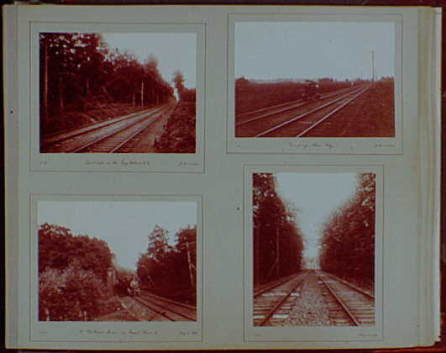
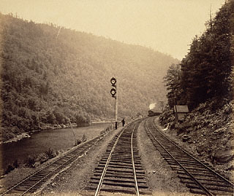
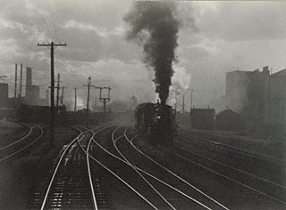
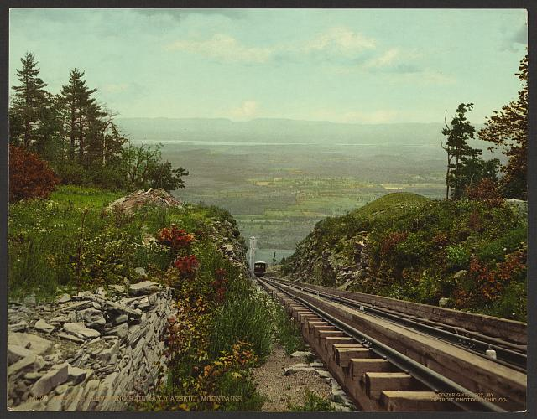
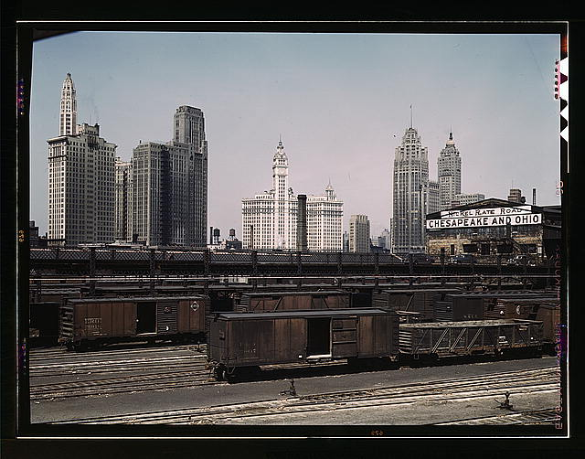
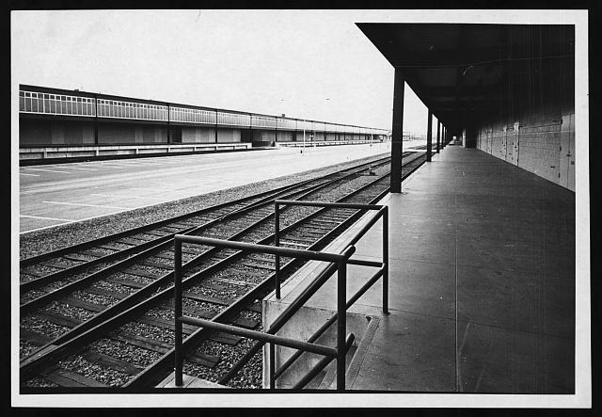
Photographic styles
Amateur
Professional
Art/Pictorial
Commercial
Documentary
News
Notes:
Amateur: Early years, snapshots, 1896-1898. Railroad scenes VIII. LOT 12820, p. [043], photographed 1898, in album, by Samuel H. Gottscho, LC P&P, gsc5a00488. 19th century hobby for the wealthy evolved due to technological innovations making it easier to take photographs. There can be serious hobbyists as well as point and shooters who take snapshots. Value of intimacy, glimpse into private realms, even if shots are sometimes out-of-focus or poorly executed
Professional: Bear Creek Curve, Lehigh Valley Railroad, about 1895, William H. Rau, Getty, 85.XM.12.2.
Art: The Hand of Man, 1902, print about 1933, Alfred Stieglitz, Getty, 93.XM.25.7. Art: both pictorial and straight photography
Commercial: The Otis Elebating Railway, Catskill Mountains, c1902 by Detroit Photographic Co., ppmsca18225, LC P&P
Documentary: Illinois Centrall R.R., freight cars at the South Water Street freight terminal, Chicago, Ill. The C & O and Nicekl Plate Railroads lease part of this terminal from the I.C.R.R., fsac1a34787, 1943 April, by Jack Delano, FSA/OWI, LC P&P.
News/Photojournalism: Factual visual reporting. Newspaper and magazine publications. [Railroad siding beside the loading dock, Hunts Point Market, the Bronx, New York City], 1967 by Nat Fein, New York World-Telegram & Sun Collection, LC P&P, ppmsca12705..
Photographic style: basic shorthand to convey combined ideas of who the creator is and who the intended audience is. These are 6 photographic styles commonly found in archives and collections.

Slide 11
2. Why
Why was the photograph taken?
Why did the photographer choose to capture the moment with this image?
Does the image tell more than what it was originally made to convey?
Notes:
Context

Slide 12
3. What
What is depicted?
What subjects are captured?
What is the content?
What are the physical characteristics?
What is the genre?
Notes:
This module will not cover common conventions for visual expression, like composition, contrast, exposure, focus, perspective, tonal range, etc. Instead reference PACM pages 62-64.
Referring to photographic genres employs a basic shorthand to convey combined ideas of what the image depicts and how it is depicted (portrait, group portrait, landscape, waterscape, still life, bird’s-eye-view, aerial view).
This is about content.
Gas ration stamps being printed, Bureau of Engraving & Printing, USN&R COLL- Job no. 29102, frame 18, LC-U9-29102-18, LC-DIG-ppmsca-03428, from film neg., 1974 Jan. 31., Warren K. Leffler, photographer, U.S. News & World Report Magazine Photograph Collection, Library of Congress Prints and Photographs Division, ppmsca 03428.
Detailed visual analysis: learn to recognize the general subject matter, what the photograph might communicate. What can be discovered just by looking at the photo?
Also, what can’t we see? What do you want to know that is not revealed by looking at the photo?
What is happening outside of the photo’s frame? We see only what is inside the frame.

Slide 13
Of and about
Of=Content
About=Context
Notes:
What is pictured
Circumstances around photo, meaning
Visual expression techniques and creator viewpoints.
[Joseph Avery stranded on rocks in the Niagara River], DAG no. 1165, Three men boating in the Niagara River were overwhelmed by the river's strong current, lost control of their boat, and crashed into a rock. The current carried two men immediately over the Falls to their deaths. The daguerreotype shows the third man, stranded on a log which had jammed between two rocks. He weathered the current for eighteen hours before succumbing to the river. The image is an early example of a news photograph., quarter plate daguerreotype, [1853 July], Platt D. Babbitt, photographer. cph3g04771, LC-USZC4-4771.
Subjects include waterfalls, marine accidents, drowning victims, danger, Niagara Falls.
OR ASK: how photo was made, what the photo looks like, and the intended audience
EX: Portraits of Hurricane Katrina victims
Think about the context of photo’s creation along with its content.

Slide 14
Read this photograph
Who?
Why?
What?
When?
Where?
How?
Notes:
NARA Title: “Marilyn Monroe, motion picture actress, appearing with the USO Camp Show, “Anything Goes,” poses for the shutterbugs after a performance at the 3rd US Infantry Division area”
Date: 2-17-1954
Creator: Dept. of Defense, Dept. of the Army, Office of the Chief Signal Officer
Photographer: Corporal Welshman
National Archives and Records Administration ARC 531435

Slide 15
Researching photographs
Pictorial histories
Photographer databases and dictionaries
Biographical directories
Genealogical sources
City directories
Maps
Clipping files
Local history
Census records
Notes:
PACM, Biographical Resources, p. 71; George Eastman House database: http://www.geh.org/gehdata.html; The Costume Detective: How to Date Old Photographs By the Costume http://www.fashion-era.com/Dating_Costume_History_Pictures/index.htm
Archivists and librarians are generally experienced researchers and know the primary sources that are available. These references cover some places to begin.
Activities as on pp. 65-73: Examine available evidence; Look for similar photos; Review in-house documentation; Check reference sources; Make a guide containing facts helpful to dating and identifying photos; Ask for help
Use additional information found with similar photos
Work from printed and online references
Maintain a visual guide or dictionary with information about people, places and events relevant to your holdings
Show the photos to people; get feedback, especially from those familiar with the subjects depicted or photo history. Don’t be shy about asking for help.
Being able to read a photograph visually is important, but combining that knowledge with words provides critical additional meaning.
Gather evidence from internal, physical and contextual clues (read the photo)
Examples of some resources available to find information? (ask participants)
Appraisal and accession notes, finding aids, provenance info
Dates and other info on other items from same collection
Photographer notes or correspondence
Published uses of images, including caption information
Guide: fact guide with information identifying places, dates and subjects covered by the photo collection so information can be recycled. Examples: dating street lighting, transportation, fashion, business history, construction projects, dates when landmarks were destroyed, changes in corporate names.

Slide 16
4. When
When was the photograph taken?
Photo dating techniques:
Incorporate knowledge of subjects depicted
Use creator information
Identify physical characteristics
Recognize photographic styles
Notes:
Knowing about photo processes for dating: Color features, Image size, Image base, Image format
Influence of photo production techniques
Photography captured a distinct moment in time within the frame.
Using photo techniques and format to date, must remember there is some variety by geographical area and photographer
Handouts and other dating sites:
19th c. card mounts: www.ajmorris.com/roots/photo/dates.htm
Phototree.com: hist/char of formats
www.gclark.com/phototree/main/history

Slide 17
Pythian Castle
Imprint: Rogers Studio, Frederick, MD.
Photographer George Edward Rogers died 1923
Building dedicated 1913
Notes:
Photo courtesy of Maryland Room, Frederick County Public Library, Frederick, MD.
Local history obituary files list George Edward Rogers, also found in local history publications and census records. Polk’s City directory for 1923-24 includes Rogers at 7 N. Market in Frederick (directories not available for every year), 1909-1910 Polk directory does not include Roger’s studio, another studio listed at same address.
Sanborn maps from 1911 do not include Pythian Castle, the Castle is there by 1922. Newspaper articles on cornerstone laying date from August 1912 (architect Kepner), building dedicated November 1913.
Photo came from the estate of an antique dealer.
April 2004, Knights of Pythias auctioned possessions and building is in disrepair.
Cornerstone: Pythian Castle A.D. 1912
1st story windows: Grayson M. Mercer, Real Estate & Ins., Lloyd C. Culler, Strout Real Estate.
B&H Radio & Electric Co. truck
BUT, know when to stop, set priorities for research and be aware of time spent. Deleted example of unidentified parade in Texas.

Slide 18
5. Where
Where was the photograph taken?
Where did the photographer chose to be?
Where has the photo been?
Notes:
Entrance to Independence Square, Philadelphia], DAG no. 1400, LC-USZC4-111119, [between 1840 and 1856], photographer not identified, Marion S. Caron collection, LC P&P, cph3g11119.
Label from back: …sw entrance to Independence Square- The men shown are James Peale, Jr. son of the noted artist of same name and nephew of Charles Willson Peale. The other Augustus Runyon Peale…”
Provenance: The family of Titian Ramsey Peale to Edmond Bury to Marion Carson, 1938.
This question also pertains to the photographer’s sense of place. Usefulness of researching geographic place
Deleted: Animal tracks in the snow, LOT 11453-1, no. 399, 1916, Frank and Frances Carpenter collection, Alaska, Library of Congress Prints and Photographs Division, ppmsc 01954.
Knowing about the original source and how photos relate to other collection materials gives meaning through context.
Review in-house documentation
Check: deed of gift, accession record, acquisition correspondence, related holdings in all formats.

Slide 19
6. How
How was the photograph made?
How is the photograph being presented?
Notes:
[Alda] sings Star Spangled Banner, lc p&p, ggbain24718, Bain News Service, n.d.
More on id in upcoming module

Slide 20
Be warned!
Don’t believe everything you see
Don’t believe everything you read
Notes:
Photo manipulation; Tricky memory
Portrait Felah Arabe/ Dumas Ph., LOT 13551, no. 59, albumen photograph, [between 1860 and 1900], Tancrede R. Dumas, photographer, Library of Congress Prints and Photographs Division, Washington, D.C. (LC-DIG-ppmsca-04462; LC-USZ62-93244)
Felah Arabe=native girl; Port Said, Egypt
What can be read (who, what, when, where (generally anyway), why, how) here? Don’t forget to be cautious about assuming
too much.
1. OED Felah: "A peasant in Arabic speaking countries, in Eng. applied esp. to those of Egypt. “
Rough translation: Arab peasant.
2. Importance of being cautious about reading too much into studio portraits from this part of the world, because sometimes the photographers had costumes and put them on people that were not the ones identified in the titles. Also, do we know enough about the dress of peasant women in Egypt at that time to know if it is appropriate? For example, her hair is showing--is that appropriate for who the photog. says she is?
Make sure that everything adds up (on target) during research, acquisition & cataloging

Slide 21
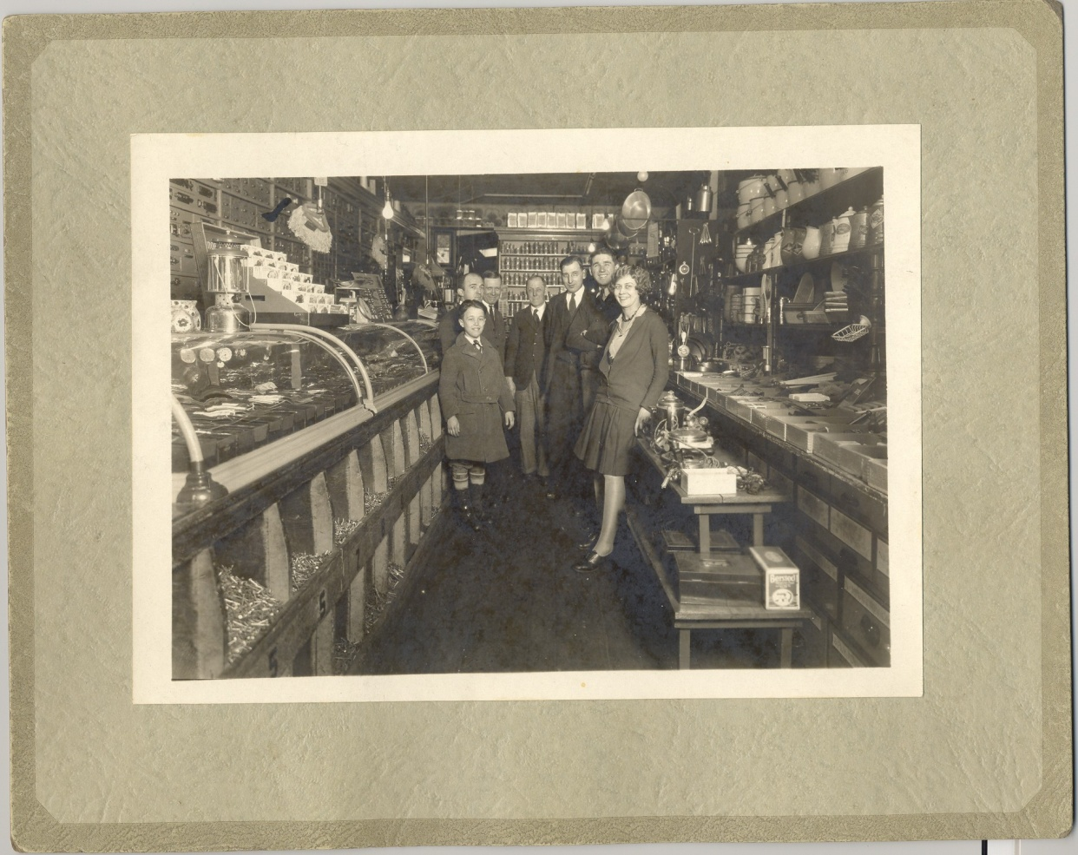
Hands-On Learning Activity
Notes:
Maryland Room, Frederick County Public Library, Quynn’s Hardware Store, see answer sheet for further details.

Slide 22
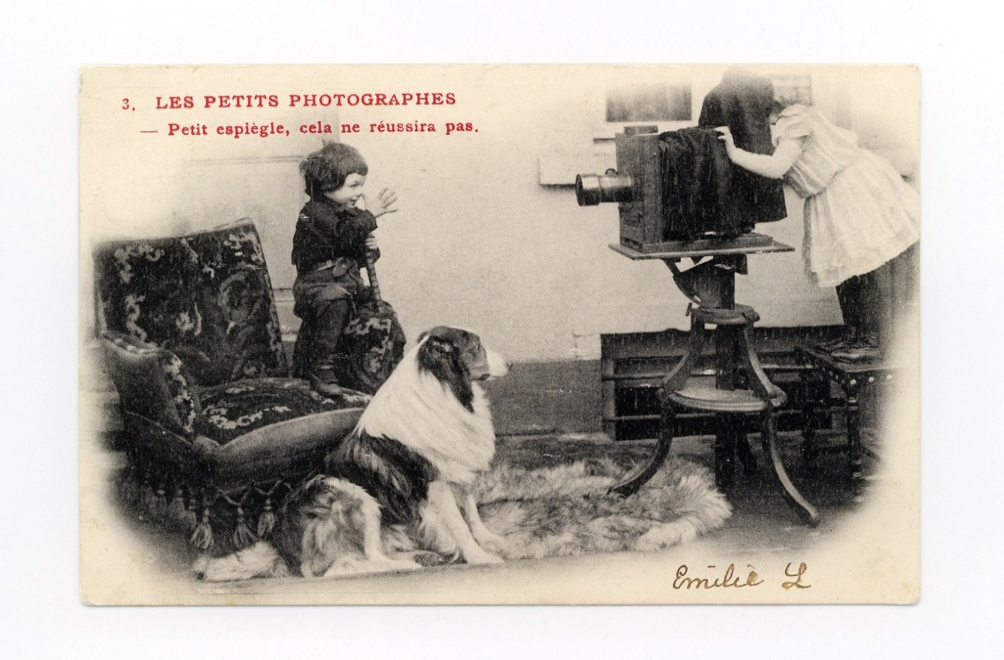
Module 2
Handling and Identification of Photographic Materials
Society of American Archivists
Notes:
November 2008
Society of American Archivists
22
Handling and Identification of Photographic Materials
A very brief overview. Much additional information in the book and in others such as Reilly, Care & Identification of 19th-century Photographic Prints” Rochester NY: Kodak, 1986.
worked large aand small institutions
I work at Library of Congress,
George Eastman House
Harry Ransom
MMA
Conservation training
What’s it made of
What deteriorates aand How
How to preserve it and then
Stabilize and restore
So that’s the perspective I will try to give you today and tomorrow

Slide 23
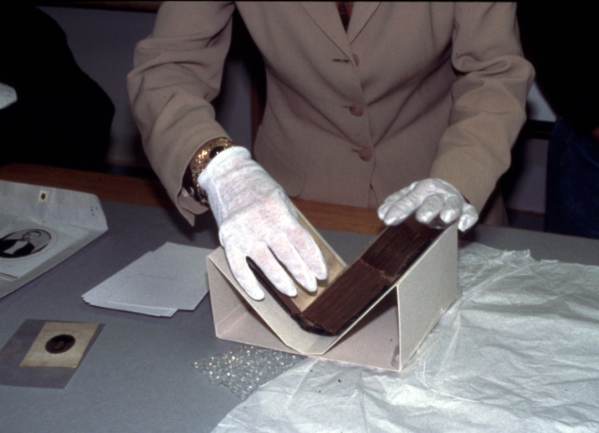
Handling Procedures
Safe handling promotes:
Long-term preservation of photo holdings in original formats
Positive reputation of institution
Retention of information
Society of American Archivists
Notes:
November 2008
Society of American Archivists
23
HANDLING PROCEDURES
Safe handling promotes:
Long-term preservation of photo holdings
in original formats
Retention of information
Positive reputation of institution
Start with some basics
I can’t emphasize this enough: you want your
institution to provide a safe home for the photographs
this starts with Safe Handling
Safe handling promotes:
Long-term preservation of photo holdings in original formats
Retention of information
Positive reputation of institution

Slide 24
Do and Don’t
Do
Have clean hands
Wear gloves
Use pencil only
Support photos at all times
Be alert about condition problems
Don’t
Touch or have contact with skin; also don't speak directly over items
Work near food or drinks
Work with ink
Put anything on top of photos
Society of American Archivists
Notes:
November 2008
Society of American Archivists
24
DO AND DON’T
Workspace: make a dedicated area or areas for handling photographs, either processing or research. Keep this space clean and clear of other materials
Tools: support boards, lifters, book supports, bulb and/or soft brush for dusting
Habits!
Wear gloves
Use pencil only on and around photographs
handle items with both hands, held flat , light but secure grasp, no thumbs!
look before you touch or move,
Use support boards to carry weak or damage photographs
use carts and enough people
watch out for handling mistakes in removing/replacing housings
Avoid touching photograph emulsions/surfaces
avoid flexing supports, Gelatin/binder can crack unexpectedly, as can brittle mounts
Do not put anything on top of the photographs
IF you step away from the workstation, cover photographs
Set a good example

Slide 25
Why is it important to ID photographs?
Aids in dating
Helps understand vulnerabilities
Guides housing choices
Determines environmental conditions
Verifies light sensitivity
Decides possible treatment options
Society of American Archivists
Notes:
Why do we want to identify photographic processes
Aids in dating
Helps understand vulnerabilities physical and chemical
Guides housing choices
Determines environmental conditions
Verifies light sensitivity
Decides possible treatment options

Slide 26
How to identify photographs
Format
Visual analysis
Deterioration characteristics
Microscopic exam w/magnification
Spot tests
X-ray Fluorescence
Society of American Archivists
Notes:
How to identify photographs What tools do we have to identify process
Format – carte des visite gives one a likely period for the photograph
Visual analysis
Deterioration characteristics – albumen binder deteriorates characteristically
Microscopic exam w/magnification - Show the 30x magnifier
Spot tests – don’t try this at home
X-ray Fluorescence – scientific laboratory
November 2008
Society of American Archivists
26

Slide 27
Structure of a photograph
Image Material
Binder layer
Baryta layer
Support
Society of American Archivists
Notes:
Generic cross section of a photograph
Complex Physical and Chemical Objects
Layered structures
Bottom to top: support, baryta, binder embedded with image material
November 2008
Society of American Archivists
27

Slide 28
Supports
Metal
Glass
Paper
Plastic
Society of American Archivists
Notes:
Foundation of photographs
What the image rests on.
Metal – daguerreotype, tintypes
Glass – ambrotypes, wet and dry plate negatives
Positive prints
Negatives, transparencies slides
November 2008
Society of American Archivists
28

Slide 29
Binder
Albumen (egg whites)
Collodion (gun cotton)
Gelatin (animal bones)
Sometimes no binder
Society of American Archivists
Notes:
Albumen (egg whites) –
Collodion (gun cotton)
Gelatin (animal bones) – turned out to be the ideal medium to hold images for black and white to color
Sometimes no binder – salted paper prints, platinum cyanotypes
Baryta – end of 19th century start to see baryta – made of barium sulphate in gelatin
November 2008
Society of American Archivists
29

Slide 30
Image material
Silver
Platinum
Iron complexes
Pigments
Organic dyes
Society of American Archivists
30
Notes:
The material that gives you the image
Light – less image material
Dark – more image material
And everything in between
Silver – most common for 19th century and most of the 20th century
Platinum – specialty process
Iron complexes – cyanotypes
Pigments – specialty processes carbon, gum
Organic dyes – color photographs

Slide 31
Types of photographs
Direct positives (often associated with cases)
Prints
Negatives
Society of American Archivists
31
Notes:
Types we will look at today – not a complete list
I have a sample collection here for you to look at examine and practice identification – they are mine and so I would ask you to handle them carefully
Coming directly from the camera – was at the scene
Direct positives (often associated with cases)
Negatives - one
Prints – made from negatives - multiples

Slide 32
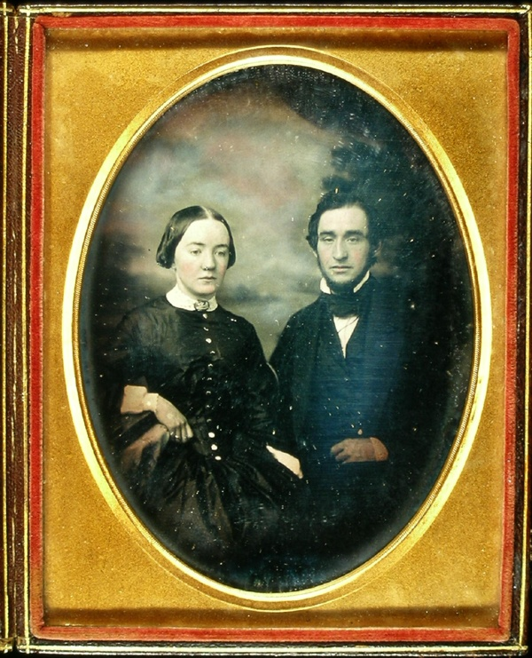
Daguerreotype Direct Positive
Dates of popularity - 1839 – 1860
Silver/gold/mercury image material on silver-plated copper support
Mirror-like surface
Positive image viewed at specific angles
Often in cases
Society of American Archivists
32
Notes:
Photography was announced to the world by Daguerre in 1839
Dates of popularity - 1839 – 1860
Silver/gold/mercury image material on silver-plated copper support
Mirror-like surface Silver plating acts as a mirror
Positive image can only be viewed at specific angles
Often in cases – this image shows only the right side of the case
Deterioration Characteristics
Like fancy flatware Silver tarnishes or oxidizes
Tarnish is common ranging in color from black to yellow
Note this daguerreotype has been enhanced with color – painted on by hand
November 2008
Society of American Archivists
32

Slide 33
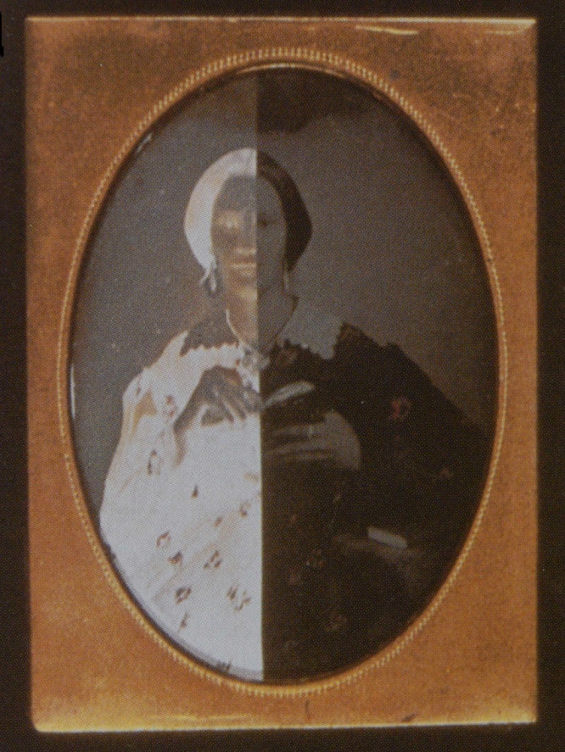
Ambrotype Direct Positive
Dates of popularity 1851-1870
Silver suspended in collodion on glass with black backing to create positive image
Often in cases
Society of American Archivists
33
Notes:
November 2008
Society of American Archivists
33
AMBROTYPE
DIRECT POSITIVE
Dates of popularity 1851-1870
Silver suspended in collodion on glass with black backing
In order to create a positive image-- lightly printed negative
Black backing is paper, cloth or is painted directly onto
the back of the glass support
Appears as negative without black backing.
Black backing reverses tonality
Positive image can only be viewed from certain angles
Most often in cases
By knowing what it’s made of you can begin to predict
what it’s vulnerabilities are
What’s vulnerable here? Glass support

Slide 34
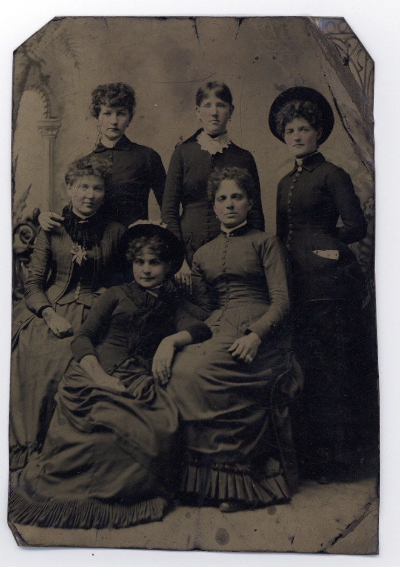
Tintype Direct Positive
Dates of popularity 1856-1880
Silver suspended in collodion on a sheet of iron with backing black lacquer interlayer
Magnetic
Sometimes in paper mats
Society of American Archivists
34
Notes:
Dates of popularity 1856-1880
Silver suspended in collodion on a sheet of iron with backing black lacquer interlayer The black backing with varnish coats the metal support
Iron support is magnetic
Sometimes in paper mats
Creamy light areas – characteristic of collodion
Often housed in a paper mats
Deterioration Characteristics
Flaking of binder from support
corrosion on iron support
Support can bend easily
November 2008
Society of American Archivists
34

Slide 35
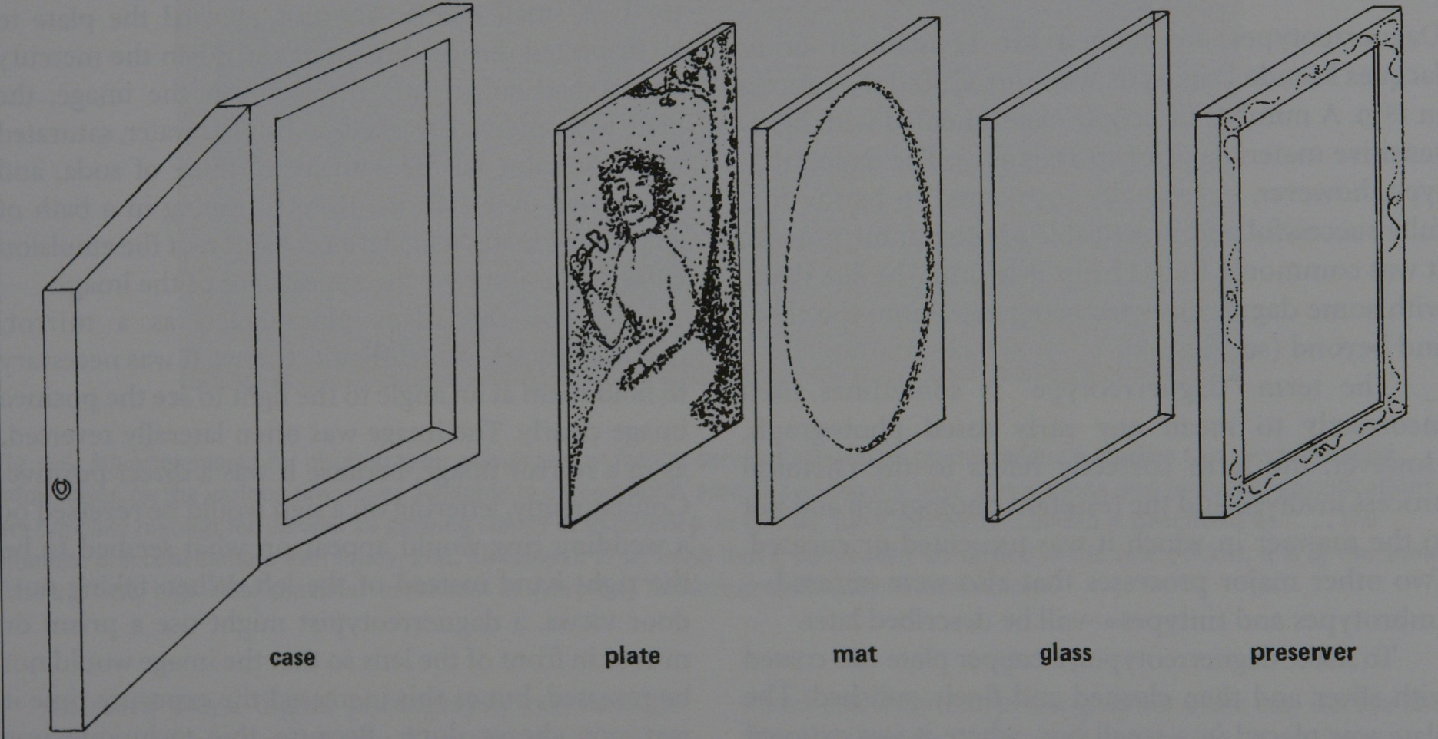
Case Components
Society of American Archivists
35
Notes:
November 2008
Society of American Archivists
35
CASE COMPONENTS
Show and identify each piece
Case
Photograph
Brass mat
Cover glass
Preserver

Slide 36
Deterioration of Direct Positives (Cased Photographs)
Corrosion of silver (dag, ambrotype)
Corrosion of iron (tintype)
Delamination of layers (mostly ambrotype and tintypes)
Glass breakage (ambrotype, cover glass)
Bent metal (tintype, sometimes dag)
Wear and tear on cases: broken hinge, missing components, fading of fabric
Society of American Archivists
36
Notes:
November 2008
Society of American Archivists
36
Deterioration of Direct Positives
(Cased Photographs)
Remember these can help with process identification
we have already talked about some of them
Corrosion of silver (dag, ambrotype)
Corrosion of iron (tintype)
Delamination of layers (mostly ambrotype and tintypes)
Glass breakage (ambrotype, cover glass)
Bent metal (tintype, sometimes dag)
Wear and tear on cases: broken hinge, missing components,
fading of fabric

Slide 37
Photographic Prints
Silver-based prints
Other print types
Common formats
Society of American Archivists
37
Notes:
Prints are typicially positive that have been made from negatives
You can make many copies – multiples
The desingation of print ususally means its on a paper support
You are able to see the image by means of reflected light as opposed to transmitted lights – negatives and transparencies
Dominant image material before color was silver
That being said there are other types that sprung up as alternatives – having different looks and aetsthetics
We will look at several typical formats

Slide 38
Print Processing Terminology
Printing-out Process (POP)
Processed with the energy of the sun
Warm tones
_____________________
Developing-out Process (DOP)
Processed in a chemical bath
Neutral tones
Society of American Archivists
38
Notes:
Terminology that will help in identifying – when making a print from a negative can be accomplished with the sun or in a chemical bath.
Printing-out Process (POP) – more associated with 19th century
Processed with the energy of the sun
Explain printing frame
Starts out a reddish brown – not aesthetic POP are often toned with gold or platinum or both
More vulnerable image particle__________________
Developing-out Process (DOP) more associated with 20th century
DOP either contact printing like POP or Or enlargement
Processed in a chemical bath
Neutral tones
More robust image particle – less subject to oxidation

Slide 39
Salted Paper Prints POP
Dates of popularity 1840 – 1855
Silver particles on paper (no binder)
Paper fibers visible
Warm tone
Society of American Archivists
39
Notes:
Dates of popularity 1840 – 1855
POP
Silver particles on paper (no binder)
Paper fibers visible – soft appearnce not sharp
Warm tone – using gold typically
Sometimes hand colored

Slide 40
Albumen Prints POP
Dates of popularity 1850-1895
Silver in albumen binder on paper
Paper fibers visible
Thin paper support (usually mounted)
Binder usually glossy
Warm tone
Notes:
Albumen Prints POP
Dates of popularity 1850-1895
Dominant 19^{th-}century process
POP
Silver image particle in albumen binder on paper
Paper fibers visible
Thin paper support (usually mounted)
Binder Slight sheen or high gloss
Warm tone typically gold
Deterioration characteristics:
highlight fading,
cracking/crazing of binder
Yellowing of binder

Slide 41
Collodion and Gelatin POPs
Dates of popularity 1885-1920
Silver in collodion/or gelatin on paper with baryta layer
Paper fibers not visible
Typically mounted on card
Warm tone (usually)
Notes:
Dates of popularity 1885-1920
POPs
Silver in collodion/or gelatin on paper with baryta layer
Baryta layer obscures paper fibers and makes the print smoother sharper. Paper fibers not visible
Typically mounted on card
Warm tone (usually) – though there are collodion prints that used platinum toning that produced a neutral gray/black tonality
To distinguish different processes, look for component layers and visibility of paper fibers.
Some processes have image material directly on paper
some have binder layer only (albumen)
and some have baryta layer (collodion, gelatin POP and DOP)

Slide 42
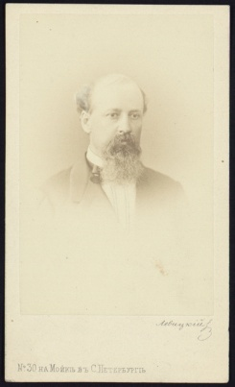
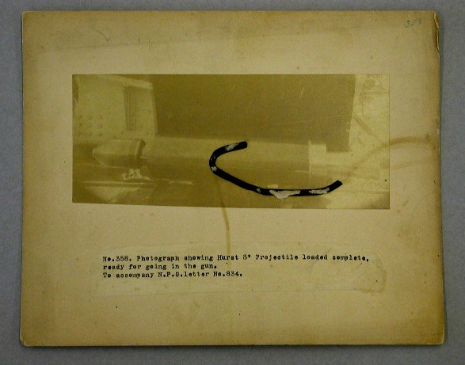
Deterioration of Silver POPs
Image fading especially in highlights
Image discoloration – yellow/brown
Yellowing & cracking of albumen binders
Sometimes see mirroring in albumen prints
Notes:
Image fading especially in highlights
Image discoloration – yellow/brown
Yellowing & cracking of albumen binders
Sometimes see mirroring in albumen prints

Slide 43
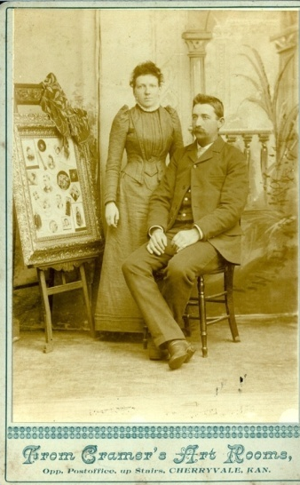
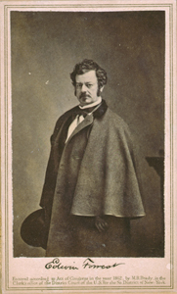
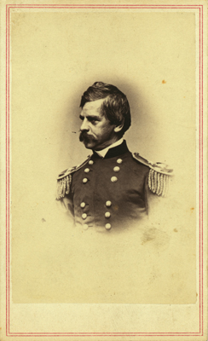
19th-Century Print Presentation Formats
Carte des visite
Cabinet cards
Notes:
Sometimes it’s easier to id formats than process.
Carte des Visite dates of popularity 1850’s – 1900’s 2.5 x 2.5 inches take their name from French calling cards
Most popular for of presentation for the 19th century photography
Cabinet cards – a bit bigger 4.5 x 6-1/4 inches 1866-1900’s
card mounts may be acidic but removal of prints is rare for reasons of safety and historic integrity. Acidity leads to brittleness—handle with care
Note any of the 19th-century processes can be found on such mounts, though albumen, collodion, and gelatin POPs are most common for card mounts
Cards usually decorated and contained the name of the photographer
card mounts may be acidic but removal of prints is rare for reasons of safety and historic integrity. Acidity leads to brittleness—handle with care

Slide 44
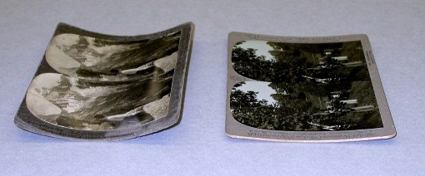
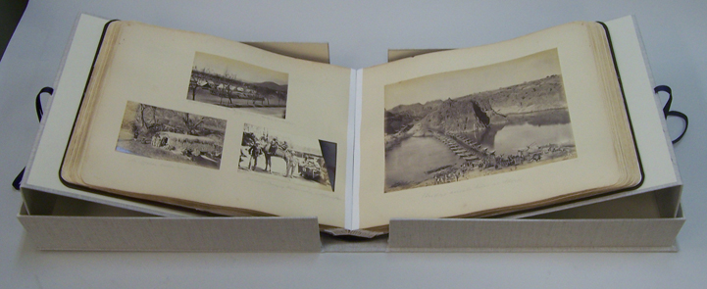
19th-Century Print Presentation Formats
Stereo cards
Albums
Notes:
Stereo cards 1850’s – 1950’s typically 4.5 x 7 inches various processes used meant to go in a viewer and provided 3d effects
stereo mounts are deliberately curved, need careful housing to accommodate the “thickness”
Albums should not be dismantled without careful consideration to the historical integrity of the album as a whole. In fact, if albums are kept closed(limiting exposure to air) and in a dry environment, even acidic pages cause little damage to the images.
Albums should always be considered fragile and handled with care
book supports to avoid opening too far
lift pages with a tool, if necessary, to avoid creasing/breaking pages
Card albums, commercial blank albums/scrapbooks, professionally published albums

Slide 45
Developing-out Gelatin Silver Prints
Dates of popularity 1885-present***
Silver suspended in gelatin on baryta paper
Fiber vs resin coated supports
Neutral black tone
Notes:
DOP = what the general public considers a “black-and-white” print
Developed-Out version came into wider use in second decade of 20th century; Dominant photographic process for most of 20th century
made in a darkroom with artificial light, so enlargement likely
Dates of popularity 1885-present***
Silver suspended in gelatin on baryta paper
Neutral black tone blacks and grays (when not deteriorated)
Variable surface textures available from manufacturers: matte, semigloss, glossy, ferrotyped and more
Multiple paper weights – single aand double weight
RC paper vs. “Fiber” paper
Resin coated papers after 1970
Typical Formats: 4x5, 5x7, 8x10; contact sheet; Polaroids
Developing-out Gelatin Silver Prints

Slide 46
Deterioration of DOPs
Silver mirroring
Flaking of binder layer especially at edges
Fading and discoloration
Yellowing/staining if poorly processed
Susceptible to high humidity
Notes:
Silver mirroring – oxidation – silver ions move to surface and then reduce back to metallic silver –
Flaking of binder layer especially at edges – when prints are trimmed
Fading and discoloration – oxidation of silver produces different color and less covering power
Yellowing/staining if poorly processed
Susceptible to high humidity sticking, mold, distortion/curling

Slide 47
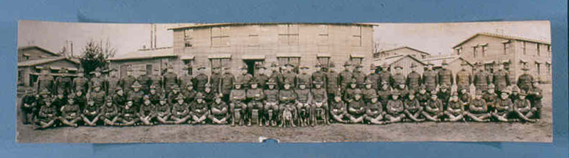
DOP Print Presentation Formats
4 x 5, 5 x 7, 8 x 10s, contact sheets, etc
Albums
Postcards
Banquet prints
Panoramas
Notes:
Standard sizes become the norm as photographic papers are all manufactured.
4 x 5 5 x 7 8 x 10 contact sheets some of them still in use today
Late 19th – manufactures began making postcard paper to print photographs on
Banquet – large field of view (banquet hall) wide angle lens
Panoramas also available in 19th century, but became very popular 20th.
DOP papers are typically heavier and so do not always need mounting – though they can be.
DOP Print Presentation Formats

Slide 48
Non-Silver Print Processes
Cyanotypes
Dates of popularity 1880-1920
Sensitive to pH
Paper fibers visible
No binder, matte surface
Light fading
Notes:
Cyanotypes are blue (same material as blue prints) ferrous ferricyanide (Prussian blue). Used for proofing and inexpensive prints.
Used in architectural world, known as blue prints
Dates of popularity 1880-1920
Sensitive to pH
Paper fibers visible
No binder, matte surface
Light fading

Slide 49
Non-Silver Print Processes
Platinum Prints
Dates of popularity 1880-1920
Steel gray black, or black brown tones
Paper fibers visible
No binder, matte surface
Paper support deterioration
Good image stability
Notes:
Platinum Prints
Dates of popularity 1880-1920
Steel gray black, or black brown tones
Paper fibers visible
No binder, matte surface
Platinum prints are extremely stable, don't fade; Platinum noble metal – better image stability
the metal catalyses the paper deterioration so you have discolored, brittle paper with a good, neutral toned image (may appear warm because of paper tone). in photographs that means the paper support. Since there is not binder nothing to protect it.
Also image may offset onto other sheets of paper, folder, interleaving, etc

Slide 50
Photomechanical Prints
Half-tone reproductions
Photogravure
Woodburytype
Ink on paper
Good image and support stability
Notes:
Just so you are aware of these options – at some point in the process
a light sensitive medium was used, but the final print is mechanically
printed with ink on paper
Good image and support stability
Half-tone reproductions
Photogravure
Woodburytype
Photomechanical Prints

Slide 51
Color Photographic Processes
Chromogenic (most common)
Silver dye bleach (Cibachrome/Ilfochrome)
Dye diffusion – Instant prints (Polaroid)
Dye imbibition/Dye transfer
Notes:
Chromogenic (most common)
Silver dye bleach (Cibachrome/Ilfochrome)
Dye diffusion – Instant prints (Polaroid)
Dye imbibition/Dye transfer
From the beginning color was sought for application in photographs.
Color in photographs was at first added by hand.
It wasn’t until the late 19th century did a viable processes appeared
and became widely available – screen plates most famous is autochrome.
These depend on transmission of light
Since that time many advances in technology to provide
color in film and still photographs.
There is carbro, and silver dye bleach (cibachrome),
dye imbibition or dye transfer and dye diffusion (instant prints).
And chomogenic which is where we will spend most of our time.
Color Photographic Processes

Slide 52
Chromogenic Photography
Organic dyes in gelatin on paper or film
Dominant color process pre-digital age
Used for negatives, prints, transparencies, slides and motion pictures
Notes:
The most common is chromogenic direct recording of color.
Made of 3 color sensitive materials incorporated into layers on the print or film.
Three layers of organic color dyes yellow, cyan and magenta Show color films that they can play with.
Includes Kodachrome, kodacolor, ektachrome, ektacolor from Kodak. Other manufacturers Agfa, Ilford, Fuji produce similar products.
Kodachrome available 1930’s
But not till 40’s were viable color prints available to wide audience. Many problems with stability in the beginning. (like digital today)

Slide 53
Deterioration of Color Photographs
Organic dye fading
Tonal shifts
Acetate and nitrate film bases are problematic
Notes:
Organic dye fading - dyes take their color though the structure of their molecules and these are quite vulnerable to change where they lose their color though modest changes in the molecule structure
There are three layers – three different molecules and three different degrees of sensitivity to light and other deterioration reactions.
As a result you can get Tonal shifts as you can see in this slide. The cyan layer had completely faded.
Also get dye coupler staining – see this if you have white margins – they are yellow
Even dark fading, so not just light fading. The stability of color dyes in traditional photography became very well understood so from the 1980’s on.
In addition to dye fading – as we will see in more detail in a moment, color negatives, transparencies and color movie film contain plastic supports that are themselves not stable materials.

Slide 54
Negatives and Transparencies
Image Materials: silver or organic dyes
Binder: gelatin
Transparent support Materials:
paper, glass plates; cellulose nitrate,
cellulose acetate, polyester
Formats: 35mm, 2.5 x 2.5, 4x5, 5x7, 8x10, lantern slides; motion picture film, etc., etc.
Notes:
Typically negatives are identified by binder type
Transparencies refers to photographs that are positive (made
from a negative) but are on a transparent support.
Image Materials: silver or organic dyes
Binder: gelatin
Transparent support Materials:
paper, glass plates; cellulose nitrate,
cellulose acetate, polyester
Formats: 35mm, 2.5 x 2.5, 4x5, 5x7, 8x10, lantern slides;
motion picture film, etc., etc.
Negatives and Transparencies
Image Materials: silver or organic dyes
Binder: gelatin
Transparent support Materials:
paper, glass plates; cellulose nitrate,
cellulose acetate, polyester
Formats: 35mm, 2.5 x 2.5, 4x5, 5x7, 8x10, lantern slides; motion picture film, etc., etc

Slide 55
Photographic Negatives
Paper
Glass base
Wet collodion
Gelatin dry plate
Film base
Cellulose Nitrate
Cellulose Acetates
Polyester
Dates of Popularity
1839-1850
1851-1880
1880-1920
1880-1925
1925 – present
1960- present
Notes:
First negatives were on paper. Resulting prints were not very sharp so inventors sought transparent support material.
Glass – with collodion at first. It had to be processed within 3-5 minutes of making. This was limiting and meant the photographer had to do this on site.
Dry plate allowed more flexibility and one could purchase already sensitive plates and develop when they wanted. But heavy and it breaks.
Film bases – Nitrate or celluloid was the first solution. This also meant that the film could be made on rolls and allow multiple shots.
But ….. Flammable, very very flammable.
So Safety film was introduced. This was made of a cellulose acetate base which was not flammable.
But… as it aged the film base began to shrink , this caused the layers to separate, channel, bubble – rendering the image unreadable.
Further, both nitrate and acetate offgass acidic vapor as they degrade – making them a hazard to adjacent materials.
Luckily, polyester is very very stable.

Slide 56
Film Base Identification
Polarization Test
Edge Printing
Dating
Notch Codes
Deterioration characteristics
Destructive Tests
Notes:
Because of these problems, you as archivists will have to identify where in your collections you have these materials so they can be segregated from other materials.
There are several ways to idenfity the film base.
Polarization Test – is a positive test for polyester – I can demonstrate this if you’d like.
Edge Printing and Notch Codes – manufacturers will use to
Dating from the image itself
Deterioration characteristics- channeling, smell of acetic acid or nitric acid.
Destructive Tests – as a last resort and probably not necessary in most cases.

Slide 57
The Problem with Color Dye and Film Stability
Organic dyes are inherently unstable at room temperature
Nitrate and acetate films are inherently unstable at room temperature
Solution: Cool/Cold storage
Notes:
Negatives & Transparencies:
Stability Issues and Storage requirements: Film bases (nitrate/acetate) and color processes are inherently unstable
Cellulose Nitrate is a fire risk, though more so with roll film and heavy sheets like x-rays than with most sheet films
Cellulose Acetate deteriorates at least as quickly as nitrate, will also lead to complete loss of image information
Chromogenic images rely on dyes that are not stable, fade in dark storage as well as light, and can discolor spontaneously
These chemical reactions happen at room temperature!
All these processes must be kept under controlled humidity below room temperature to prolong their period of usefulness

Slide 58
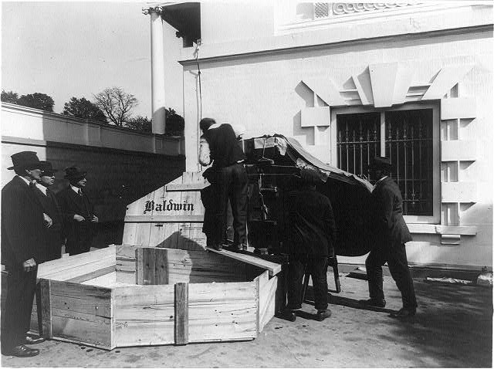
Module 3 Preservation & Storage
Notes:
Because photograph conservators are relatively rare, you must become an advocate for preservation!
You are the first and perhaps only line of defence for your collections, and
you should get whatever additional knowledge needed to do this aspect of your job responsibly.
Speedy introduction only
Assumes prior knowledge of broader preservation issues
Ask questions if anything is unclear or unfamiliar
Get more in-depth training on any topics where you need more detail (there is a lot out there)
Of course lots valuable on the web now.
NEDCC NPS
LC
Module 3 Preservation & Storage

Slide 59
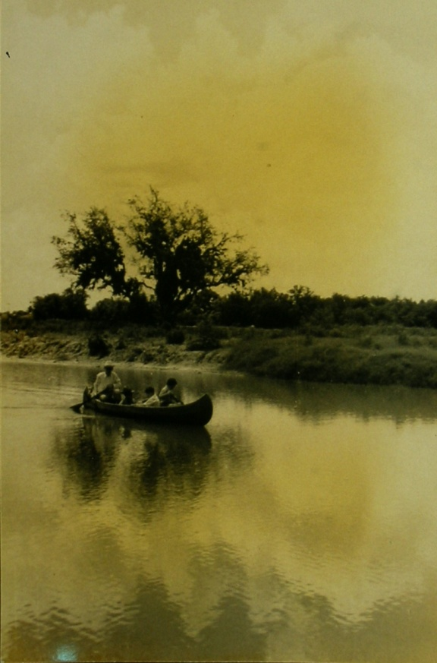
Deterioration of Photographs
Residual processing chemicals
Damaging storage materials
Damaging adhesives
Emergencies
Mismanagement
Mishandling
Notes:
Residual processing chemicals
Damaging storage materials
Emergencies
Mismanagement
Mishandling
Residual processing chemicals - After the image is developed (by sun
or chemical bath) the remaining light sensitive materials still in
the emulsion have to be removed or the whole image will turn black.
This is done with Fixer, or sodium thiosulfate. If not properly removed
will itself cause deterioration of the photograph –
resulting in brown stains fading and discoloration.
Damaging storage materials – acidic backboards, older envelopes,
Emergencies – first or water damage – very destructive to photographs
Mismanagement don’t separate out nitrate/acetate film.
People leave their photographs in basements or attics.
Mishandling – lack of handling policies.
Deterioration of Photographs

Slide 60
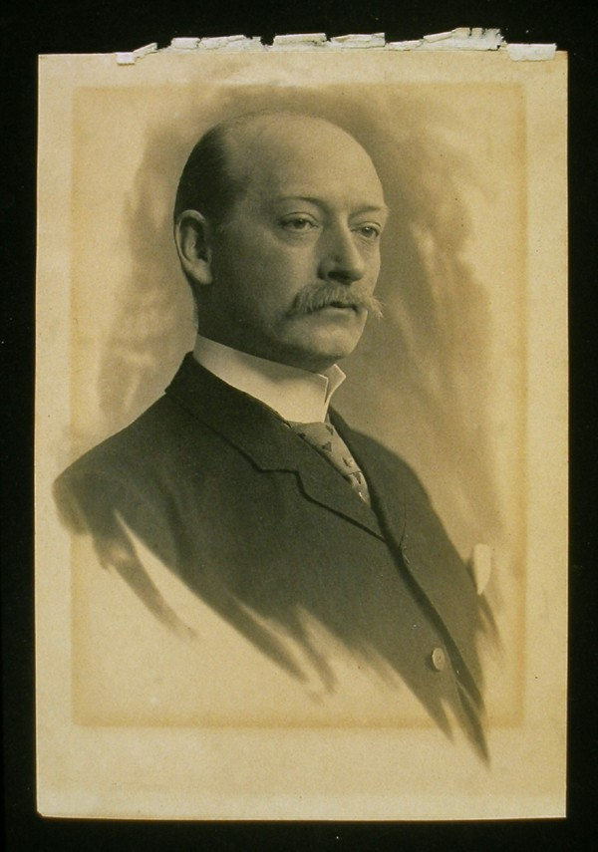
Deterioration of Photographs
Environmental causes
Temperature
Relative humidity
Contaminants
Light
Biological and microbial
Notes:
Deterioration of Photographs
Environmental causes
Temperature
Relative humidity
Contaminants
Light
Biological and microbial
The control of the environment where photographs are
kept is CRITICAL to their preservation r
egardless of how good or bad their previous lives were.
Move on.

Slide 61
Environmental conditions
Temperature – Increased temperature promotes deterioration reactions.
Relative Humidity – Some deterioration reactions require moisture.
Notes:
ENVIRONMENTAL CONDIITONS
Temperature – Increased temperature
promotes deterioration reactions.
Relative Humidity – Some
deterioration reactions require moisture.
Temperature – the higher the temperature the faster chemicals proceed.
This includes deterioration reactions. Lower temperatures slow down these reactions.
Relative humidity – High humidity promotes water dependant chemical reactions,
including dye fading and film deterioration.
Further fluctuations of both can also cause problems.
Aim – evenly kept cool, low humidity conditions.
Everything benefits – except maybe humans.
High levels of humidity encourage mold grown, softens gelatin
Hastens degradation of inherently unstable materials
Accelerates natural aging of stable materials
For every 10F halves deterioration rate
For every 20 5 halves deterireaiton rate (can’t go too low or will dessicate)

Slide 62
Environmental conditions
B/W silver gelatin prints
B/W silver image on glass or metal
Chromogenic dye on polyester film base
64°F 30-50% RH
64°F 30-40% RH
36°F 20-30% RH
Compare example conditions in book:
B/W silver gelatin on cellulose ester film base
Chromogenic dye on cellulose ester film base or paper
Refer to p. 216-217 in the textbook
Notes:
I don’t want to spend time on the exact set points, but I will point out that a range like 30-50% is not that the rh can fluctuate between these two limits.
Pick a set point and try not to let it vary more than 5% either direction.
With temperature try to keep the variance 2-3 degrees above or below your set point.

Slide 63
Monitoring Environment
Preservation Calculator (IPI)
Monitoring photograph collections
Hygrothermographs
Dataloggers
IPI: PEM and Climate Notebook
Hanwell
Hobo (Onset)
Notes:
Preservation Calculator (IPI)
Monitoring photograph collections
Hygrothermographs
Dataloggers
IPI: PEM and Climate Notebook
Hanwell
Hobo (Onset)
To inform yourselves and provide back up numbers when you need to
talk to mechanical maintained staff and ask for money to improve conditions.
You must monitor the spaces where you keep your collections –
storage, processing areas, exhibits, and reading rooms.
There are many options available, depending on available funds.
The preservation calculator is an online tool that the
Image Permanence Institute (IPI) has developed to aid
those involved with the care of collections.
You can enter in your environmental data, plus the type of collections
you have – prints, film, paper, furniture whatever and it will tell you the life
expectance of the items at given temperature and relative humidity.
It will show you how much time you can buy with x amount of degrees
cooler or less moisture in the air.
Monitoring Environment

Slide 64
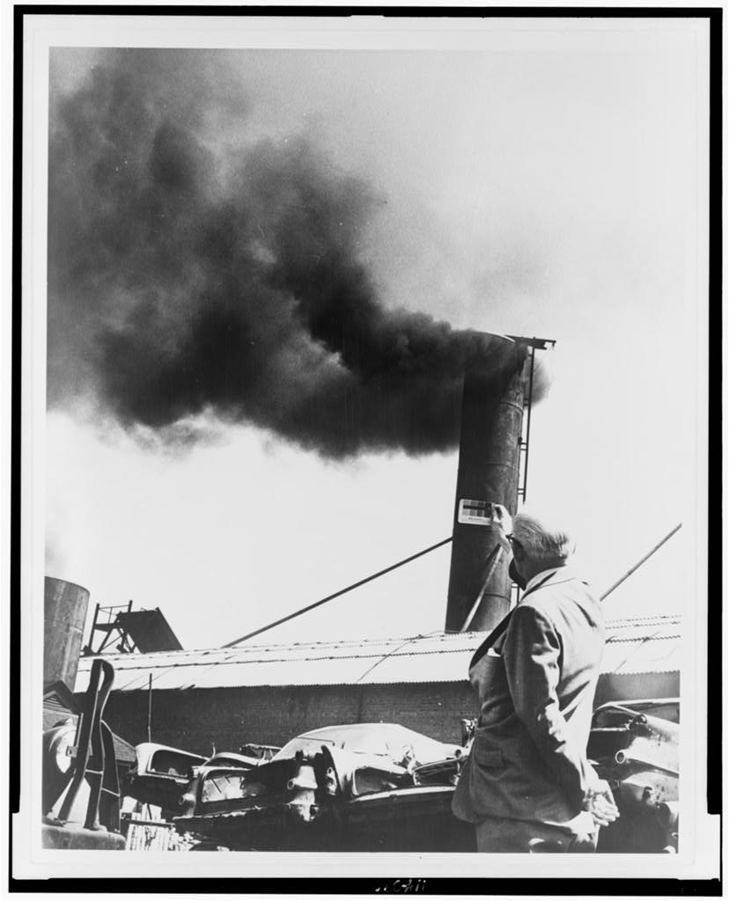
Environmental control
Light
Air quality
Pests
Fire
Water protection
Mold
Notes:
Light
Air quality
Pests
Fire
Water protection
Mold
Light:
Consider light levels for processing, research use, and exhibition
light damage if Irreversible aand Cumulative and depends on intensity and duration
Sensitive materials needing reduced light levels
UV most damaging but high end of visible spectrum is also damaging. Sun, fluorescent lights.
Light provides energy to some damaging reactions such as oxidation of paper and film bases. Fading dyes
Air quality
Gas and particulate contaminants – can cause and promote detereriotation of all components in a photographs. So2 HS peroxides ozone will attack silver and cause fading, staining, mirroring.
Get to know how the air handling systems work in your storage areas. Proper scavengers for gaseous pollutants and filters for particulates should be installed and MAINTAINED.
Sources of air pollution can also be in paints, cleaning solutions. Building materials, carpets, wood frurniture
Fire& Water protection
Identify fire protection in your building. What systems are in place. Where is the nearest fire house. What suppression systems are in place. Have they been maintained. If things get wek act quickly arrange storage to protect from water pipes,
Biology – mold, fungi, insects and rodents especially warm humidity
Mold gets nutrients form gelatin and paper
Iinsects silverfish, cockroaches, beetle aand rodents will feed on photograph anod paper collections.
If you find mold, sequeste it and call a conservator.
Environmental control

Slide 65
Cool and cold storage
Humidity-controlled vaults vs. Commercial Freezer options
“Passive” systems
Consider access and use requirements
Proper packaging
Special handling
Notes:
Humidity-controlled vaults vs.
Commercial Freezer options
“Passive” systems
Consider access and use requirements
Proper packaging
Special handling
There are some options for obtaining cool and cold storage.
You can work toward dedicated rooms with separate air handling t
o create humidity controlled vault
If not possible you can purchase commercial freezers that are
cheaper to purchase and runthat with appropriate packaging will work well.
There are companies that will sell you the supplies you need to do this.
Access is an issue with cold/cool storage.
Items are more brittle when cold and if you take the out without
protection condensation will form on the item and this is harmful.
Cool and cold storage

Slide 66
Environmental conditions
Making sense of the recommendations:
Monitor existing conditions
Evaluate needs of your collections
Do whatever you can, as soon as you can
Look for ways and means to make bigger improvements over time
Notes:
Making sense of the recommendations:
Monitor existing conditions
Evaluate needs of your collections
Do whatever you can, as soon as you can
Look for ways and means to make
bigger improvements over time
Monitor existing conditions – Can start with getting a datalogger and
accumulating data. It’s good to get a year’s worth then you can see
seasonal trends and identify mechanical failures in the buildings HVAC system.
Evaluate needs of your collections – Because you can now identify
the processes in your collection you can begin for form a profile for
environmental needs. Do you have color and how much. Acetate, nitrate?
Do whatever you can, as soon as you can. Baby steps.
This will also give you time to make adjustments as needed.
Look for ways and means to make bigger improvements over time
Environmental conditions

Slide 67
Preservation assessment
Risk and needs assessment
Condition, use, value
Health and Safety concerns
Recordkeeping
Evaluate archival policies and practices
Training
Society of American Archivists
67
Notes:
November 2008
Society of American Archivists
67
Risk and needs assessment
Condition, use, value
Health and Safety concerns
Recordkeeping
Evaluate archival policies and practices
Training
A preservation assessment is a great first place to start.
It provides you with a to do list after it’s done.
Identify your short and long term hazards such as housing materials,
lack of segregated unstable film,
See if you have active mold or biological infestation
Lack of reference copies of heavily used originals
Damaging housings
Condition problems – torn prints, tightly rolled pans. Broken glass
Address each of these as they apply – i.e. incoming collections should be
examined in a separate space to see if there has/was mold, unwanted biology.
Develop priorities based in high use, chemically unstable, and value.
But can’t do this until you conduct a preservation assessment.
Health and Safety for staff. Acidic fumes are an irritant and if exposed
to long unhealthy. Mold is unhealthy.
Evaluate archival policies and practices with the eyes of a preservation specialist.
Proper training of staff and volunteers is clearly important.
CAP program. Bring a conservator to your institution and it will result in a report.
Preservation assessment

Slide 68
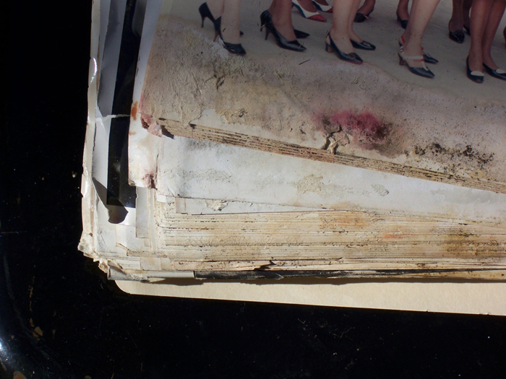
Emergency preparedness
Have a response and recovery plan
Photos vulnerable to water
Salvage operations
Set priorities
Society of American Archivists
68
Notes:
November 2008
Society of American Archivists
68
Have a response and recovery plan
Set priorities
Photos vulnerable to water
Salvage operations
There are now many references for developing an emergency plan –
for all sizes and types of collections.
It will make a profound difference in what and how much can be
saved in an emergency if you’ve planned.
Know what types of collection and where because response
difference for some processes
Air dry mostly but some can be frozen to buy more time. Some processes
need to be retrieved first as they cannot be in water long if at all.
Emergency preparedness

Slide 69
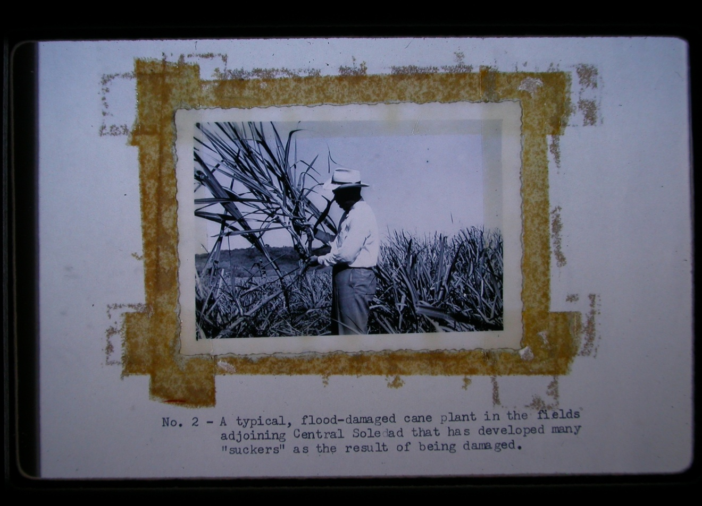
Conservation
Society of American Archivists
69
Notes:
November 2008
Society of American Archivists
69
What’s wrong here?
As you process and organize your collections make note of condition
problems that may need the attention of a conservator.
You can retrieve it when funds and time permit.
Conservation

Slide 70
When to call a conservator
High Priority
Consolidate flaking or lifting emulsion
Flatten rolled prints
Mend tears
Remove pressure-sensitive tape
Separate blocked or adhered photographs
Deal with active mold
Stabilize physically damaged photograph
Society of American Archivists
70
Notes:
November 2008
Society of American Archivists
70
High Priority
Consolidate flaking or lifting emulsion
Flatten rolled prints
Mend tears
Remove pressure-sensitive tape
Separate blocked or adhered photographs
Deal with active mold
Stabilize physically damaged photograph
It’s important to seek the help of a conservator because you can
cause irreparable harm to the item without the experience.
the problems listed above can lead to further damage and loss of image.
Conservators know what materials to use that won’t cause problems
Best way to keep damage minimal stabilize and if necessary cosmetic compensation.
Conservators can also help
Inspect film base of negative collections and evaluation of state of deterioration
Develop or review handling procedures
Establish archival storage procedures.
When to call a conservator

Slide 71
Module 4 Appraising and Acquiring Collections
Know your repository
Mission
Current holdings
Stakeholders
Resources
Notes:
Interior of L.C. Handy Studio, 494 Maryland Ave., SW, Washington, D.C., with piles of glass negatives dating back to Mathew Brady on the left and camera under cloth on the right] / photograph by the Library of Congress. 1954 Aug. 6. Courtesy of Library of Congress Prints and Photographs Division. from http://hdl.loc.gov/loc.pnp/ppmsca.03439
How to decide what to do with a collection offer that looks like this?
Review basic archival principles and how they apply to photos, refresher for some, set-up for case study.
Type of organization: two tiers, first public/private, then underneath that by general type (corporate, religious, university, government, thematic).
These types of organizations may behave very differently. For example, a public archives tends to provide equal access to all under the law, but may offer some special services to internal staff. A private repository may have a very complex hierarchy of types of services or may not offer many services at all depending upon mission and resources.

Slide 72
Mission
Objective
Audience
Services
Notes:
Colorado. Branding calves, by Detroit Photographic Co., [between 1898 and 1905], LC P&P, photochrom, ppmsca.1787.
Mission (goals), purpose, collecting mandates, and restrictions policies all affect what a repository does and how.
Levels of service:internal and external groups/ different categories of requests such as researchers with appointments, walk-in researchers, telephone calls, fax, email, and other requests.
Time on 1) checking citations, 2) providing captions, 3) searching out badly cited documents to make copies at a remote, and 4) conducting research for a researcher at a remote. Save staff time by having pre-printed or online forms that provide information about ordering copies, preparing captions, and credit lines, determining copyright status, and submitting permission to publish forms.
Limited services and hours of accessibility to the general public for smaller shops. Focus on self-service so that researchers can use Websites and other tools to identify what they want without needing staff assistance. Services performed at cost recovery levels so that staff do not need to spend salaried hours handling duplication services—but rather this is contracted out.
Policy not to sign permission to publish forms, in order to avoid lawsuits, as well as to charge back all fact-checking or research work done for the general public above 15 minutes work.
Provide list of potential contract researchers who can help remote researchers with their work. Extended assistance level to members of congress, members of the press, Board members, and executive members of their Friends Group.
Services and mission impacted by resources and partnerships/stakeholders as well as holdings.

Slide 73
Current holdings
Impact acquisitions and planning
Survey backlog
Identify strengths
Fill gaps
Identify out-of-scope materials
Notes:
Parke, Davis and Company, manufacturing chemists, Detroit, Michigan. Another view of the shelves in the freezing room for blood plasma, LC-USW3-033655, 1943 May, Arthur S. Siegel, FSA-OWI, fsa8d39313
Current holdings help shape what a repository acquires, as we try to fill in holdings gaps and identify strengths to build upon.
Collecting techniques and mandates may involve a Records schedule or Collecting policy, or both. A records schedule is a formal written agreement indicating what is permanent, what is temporary, how long temporary materials are kept before disposal, and where permanent records go when no longer needed for current business.
A collecting plan is an indication of what a repository will acquire in terms of theme, source, eras, geographic coverage, formats, document types, etc.
DELETED: Tempting as it may be to add the out-of-scope image, you should work at following your collecting policy regardless of the beauty of the image. Transfer it to the repository that collects images of Wyoming. Ansel Adams (1902–1984), "The Tetons--Snake River" Wyoming, 1942. Vintage signed print. Records of the National Park Service. (79-AAG-1), Courtesy of the National Archives and Records Administration.
Check documentation, then transfer
Deaccession the entire accession, then transfer
Weed the materials
Sample the materials
Disposition options
Note: Talk to donors, reference staff, and stakeholders early and often.
Don’t acquire it.
Don’t take out of scope donations that don’t match mission, collecting policy, and stakeholder needs. Don’t accept new collections that clearly are beyond your ability to manage using their current or grant-funded resources. Instead refer them to someone else who collects in this area. If you must acquire it, ensure that you can get rid of it by making certain the donor knows they may transfer or weed or sample it.
Check the accession’s documentation and transfer
Deaccession the entire accession if little has value, then transfer
Weed the materials (time consuming)
Sample the materials (time consuming)
On occasion you may be told that a significant out-of-scope image will be destroyed or lost if you don't take it. Your collecting policy and documentation strategy may protect you by prohibiting you from acquiring such materials. If not, try to refer the donor to another more appropriate repository. If this does not work, take the material but state in your deed of gift that you may transfer the image to a more appropriate repository or dispose of them in the future. Indicate that you will not accept donor restrictions on transferring the image. Transfer the image ASAP to a more appropriate repository.

Slide 74
Stakeholders
Communities documented
Members
Donors & funders
Partners & sponsors
Researchers & users
Staff & volunteers
Notes:
Daytona Beach, Florida. Bethune-Cookman College. Students in the library reading room, LC-USW3-014835-E, 1943 Jan. Gordon Parks, FSA-OWI, LC P&P, fsa8d24709.
Stakeholders (e.g. users, donors, staff, other partners and those documented) as the ultimate users of photographs are the audiences we acquire materials to please. Their interests and focuses help shape what we do.

Slide 75
Resources
People
Space
Funds
Supplies
Equipment
Policies
Notes:
Seventy-one years, or, My life with photography. Autumn, Greenwich, Nov. 3, 1939, LOT 12400, p. 100, photographed 1939, Samuel H. Gottscho, LC P&P, gsc5a00129
Note caption: The smoke of burning leaves, a pictorial asset.
Resources shape what we can and can not acquire including space, staffing levels, and funding for contracts, supplies, and equipment.
Staffing levels and expertise help shape what we can acquire. If a collection requires major research, legal review, and preservation treatment but we lack staff to do the work or resources to contract for the sources, or fundraising expertise, it may be irresponsible to take the collection on and let it sit and self destruct in our storage areas while we await a day of plenty that may or may not come.
Storage and work space availability limit the size of what we can acquire and may force us into sampling or weeding or deaccessioning if we can’t rent offsite storage space or move to larger facilities.
Funding limits the supplies, contracts, staffing, and equipment we have available to do our work and may prohibit us from taking on more challenging collections.
Supply and equipment availability are essential for basic acquisitions.
[not a resource, a warning] Current workload commitments should ensure that we do not take on new acquisitions that we can’t process, preserve, describe, and make available in a reasonable amount of time or we lose credibility with our users, donors, and stakeholders.

Slide 76
Documentation
Policy and Procedures Manual
Surveys
Deeds of gift & records schedules
Accession & transfer
Description
Preservation
Reference & outreach
Checklists for key activities
Notes:
Avoid reinventing the wheel each time you start a new process, have a procedures manual explaining basic steps. Pass on protocols to new staff, and captures knowledge of retiring staff. The manual should constantly be in flux. Being updated.
Copies of useful forms may be found on the Visual Materials Website, described in PACM or locatable via the SAA Website.
Procedures manual: Documents life-cycle beginning at acquisition through outreach, inc. building reviews, mission, policies and procedures (collecting policy,)
Documentation Strategy, agreements between multiple repositories about who will collect what; Records schedules, legal agreement between a repository and a creating organization of what will be transferred to the repository, when, and by whom; Accessioning, how the data is recorded, and how materials may be acquired and legally accessioned; Processing procedures, Access and use: caption and credit line, permission to publish, and copy and duplication procedures, Outreach: exhibit loans, tour protocol, partnership agreements
PACM Appendix 4-A: Sample Records Schedule, p. 128; PACM Appendix 4-B, Sample Collection Development Policy, p. 129
Collecting plans are usually developed by all staff once the staff have identified the gaps and reexamined their mission and core audience.
Customer service plan may also exist in larger repositories. When planning an acquisition campaign you need to reexamine your customer service plan to see if you are missing any potential communities of interest or other stakeholders.
Appraisal committee is a group of colleagues, stakeholders, and staff who advise the individual responsible for acquisitions and are responsible for setting priorities. The group might include a curator, lawyer, PR person, photographer, as well as your archivists and reference staff. Can rank potential accessions according to value, use and risk when conflicts arise.

Slide 77
Appraisal
Value
Use
Risk
Glossary: The process of identifying materials offered to an archives that have sufficient value to be accessioned.
Notes:
W. & J. Sloane National Art Week, 5th Ave. & 47th St., New York City. Mrs. Benjamin Rogers & Mr. McKim selecting paintings, front view, LC-G612-41365, 1941 Nov. 5, Gottscho-Schleisner, Inc., Gottscho-Schleisner Collection, LC P&P, gsc5a07896
SAA Glossary: “The process of identifying materials offered to an archives that have sufficient value to be accessioned.”
Appraisal considers “the records’ provenance & content, their authenticity & reliability, their order & completeness, their condition & costs to preserve them, & their intrinsic value. Many archivist believe that appraisal should take place within a larger institutional collecting policy & mission statement.”
“Photo archivists have developed an unusually strong impulse to avoid thinking about the need for selection. After all, we have told each other, the most urgent task is to save what remains of the early photographic legacy…Increasingly, however, the enormous bulk of 20th century photography will force photo archivists to confront the necessity of appraisal, meaning selection.” William H. Leary. The Archival Appraisal of Photographs (Paris, UNESCO, 1985).” Refusal to appraise photographs, first because they were scarce, then we began to drown in images in the 50s and 60s, we still avoided appraisal because we had no practical or thoughtful way to do it. Don’t be full of useless images that have little value to your repository & users.
Provenance & content: refers to their history of ownership, custody, and origins,
Authenticity & reliability: genuine & free from tampering. Original, made by the photographer named, captions pass reality checks, located within an accession with intact original order & provenance, not a later retouched copy. For example is it really a picture of the American West in the 19th century or is it one of those beach town pictures of 21st century folks dressed up in 19th century clothes?
Order and completeness: original order of the collection imposed by the creating individual and the removal of items, which can make it incomplete.
Condition and preservation costs: need for conservation treatment, research, or mitigation before the holdings can be used.
Enduring values: information, associations, evidence, and artifactual qualities of the collection images,
Relevance to the repository stakeholders and mission: core need for all new acquisitions

Slide 78
Value
Informational
Evidential
Associational
Artifactual
Notes:
Beauty contest during July 4th celebration at Salisbury, Maryland, LC-USF33-020635-M4, 1940 July, Jack Delano, FSA-OWI, LC P&P, fsa8a34378.
Enduring Values are core decision criteria. All 4 values combined are known as “Intrinsic Value.” (may not necessarily include informational value)
1. Informational (e.g., who, what, where, why, when, and how),
2. Evidential (e.g., activities and functions of the core group or individuals documented by the repository as identified in the mission statement or collecting policy or records schedule) Strongest when supported by related records, have a chain of custody and intact provenance, in original order, complete (e,g., not weeded), linked directly to the repository via a records schedule.
3. Associational (e.g., link to a key person, place, event, or group documented by the repository) Association may be not only to photographs he is in, but also photographs he took or collected or wrote about,
4. Artifactual (e.g., condition, generation, quality, process, rarity, visual vocabulary). High value to camera original negatives or early copies, images in original albums, photos made by or in unusual historic processes, photos printed from the darkroom by the original photographer or their selected technician, pristine or undeteriorated images, unique or direct positive images, vintage prints and transparencies.
One additional value not described here is Monetary Value: changes day-to-day based upon the market.
SAA Glossary: Intrinsic value is: The usefulness or significance of an item derived from its physical or associational qualities, inherent in its original form and generally independent of its content, that are integral to its material nature and would be lost in reproduction.”

Slide 79
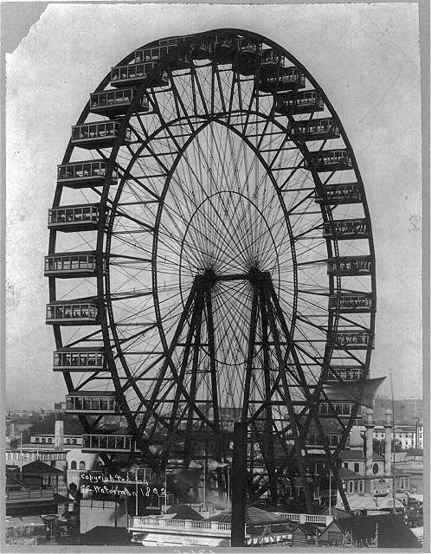
Informational value
Glossary: The usefulness or significance of materials based on their content, independent of any intrinsic or evidential value.
Notes:
[Ferris wheel at the Chicago World's Fair], SSF-Ferris wheels, cph3a50979, c1893, Waterman Co., Chicago., LC P&P.
Information useful for purposes beyond what they were originally created to do. Answers questions (who, what when, where why & how).
Information about: Chicago World’s Fair; Expositions; Ferris wheels; Amusement rides; Photographer; Chicago. “Devil in the White City”

Slide 80
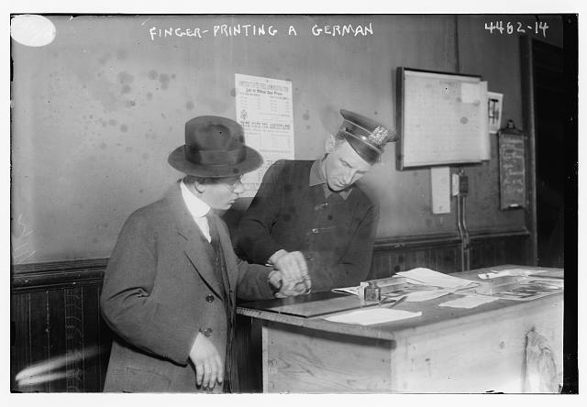
Evidential value
Glossary: The quality of records that provides information about the origins, functions, and activities of their creator.
Notes:
NYC police fingerprinting a German, 1917, photo by Bain News Service, 1917, George Grantham Bain Collection, ggbain26155, LC P&P
Evidence of activities, functions and origins of creators like a fingerprint. Photos as legal evidence as well as evidence about the core group. Photos in the context of records management functions.

Slide 81
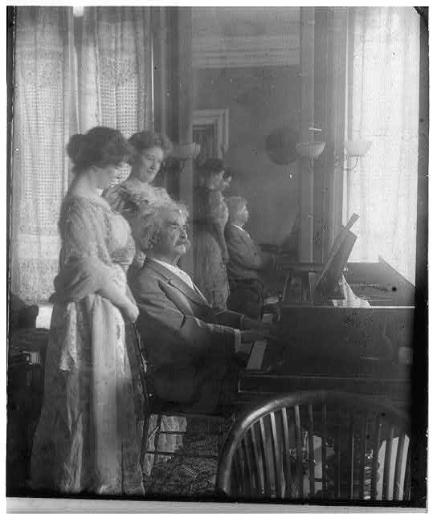
Associational value
Glossary: The usefulness or significance of materials based on its relationship to an individual, family, organization, place, or event.
Notes:
If used, note that value would be higher if signed or inscribed with words of wisdom by Clemens or owned by a family member and passed down through generations.
Samuel Clemens with Clara Clemens and her friend Miss Marie Nichols, c1908 by Underwood & Underwood, cph3a02910, LC P&P
Connectivity to people who made the images, or gathered them into collection.

Slide 82
Artifactual value
Glossary: The usefulness or significance of an object based on its physical or aesthetic characteristics, rather than its intellectual content.
Notes:
Received high usage based on attractive composition, mastery of the medium, creativity of creators and technical ability. Typically selected for publication and exhibition.
Lewis Hine (1874-1940) "Power house mechanic working on steam pump" 1920. Vintage print. Records of the Work Projects Administration. (69-RH-4L-2) Courtesy of the National Archives and Records Administration.

Slide 83
Use
Research
Evidence
Display
Material culture
Outreach
Visual sweeteners
Notes:
A jolly crowd in the surf, Coney Island, New York, stereo c1903, copyrighted by William H. Rau, cph3b14027, LC P&P.
Research resources/info.
Evidence of activities & functions of the organization
Exhibits, publications, products, outreach & websites: Expressive source material (artifact/assoc.)
Material culture supporting study
Tools that link us to a time and place; attract stakeholders from the key communities documented
Visual sweeteners (artifacts/assoc.) to serve as banners, page headings, and so forth

Slide 84
Use statistics
Call slips
Copy requests
Requests for permission to publish, loan or exhibit
Notes:
Gov. Hall and judges of the Supreme Court of La., BIOG FILE-Hall, Luther, LC-USZ6-1852, c1913, cph3d01852, LC P&P,
Talk to collection creators, reference staff and users; Look at equivalent collections
Use is the second great factor for gauging the worth of accessions to a particular repository.
Usage patterns tend to be based on how a repository is defined within the user communities.
Yet another part is due to ever changing themes in scholarship and may be at least partly predicted by those reading the historic literature. In most local repositories, local history and local communities have continuing interest in photographs of their communities, members, activities, and functions.
Aids in research about user metrics.

Slide 85
Risk
Health & safety
Preservation
Reputation
Resources
Sensitivities
Restrictions
Notes:
The “human fly” otherwise known as John Reynolds giving an exhibition of his skill on the roof of the Times-Herald Bldg. Was[ington] D.C., LOT 12296, vol. 1, p. 11, 1924, National Photo Company Collection, cph3b45873, LC P&P
Daredevil: PR, legal and ethical risks. All work has some risks, working with photographs is no different. Not to frighten you, but rather to help learn how to manage the risks effectively and how to be aware when a risk level is elevated enough to require special action. Think about when risks increase or decrease (general and vague). Risks vary greatly from situation to situation, person to person, and even period to period. It is not possible to talk precisely about risk—merely to provide accurate guidance in how to identify it and manage it.
Rights: Legal issues and restrictions, copyright, privacy, publicity, protected location info, ownership issues; unidentified copyright status, heavy or permanent donor restrictions, unclear publicity rights issues, nude images, medical or psychiatric images, embarrassing photos of living private individuals, ownership issues, and restricted information. Avoid lawsuits.
Sensitivities: Ethical issues, obscenity, access and use. Drive away donors, staff, users and those documented plus negative PR for organization. Native American Protocols.
Health/Safety Risks: For staff and users, includes Preservation problems, mold, insects, vermin, flood residue, asbestos, chemical/biological contamination, deteriorating film, since they can cause major health and safety risks to your repository, particularly for immune compromised staff or users or for those with allergies. Look for this during appraisal surveying.
Preservation risk: Nitrate film or a large panorama glass plate negative: obvious risks is fragility and complicated to store and handle. Another might be that it was coated with a flaking coating or handtouched with a flaking colorant.
Resources: Staff, space and $ for supplies/equipment, which can lead to inability to function effectively, risk to PR
Responsibilities to donors, users, and taxpayers, including not to damage the privacy of documented people or donors; pose few risks to staff and users health and safety; avoid infringing the rights and equities of the collection donors, rights holders, users, and staff; preserve holdings, and avoid using all resources for a peripheral activity so that day-to-day work can’t be done
Survey the collections; Review the documentation; Talk to creators/owners of photos; Research creation/creating context; Look at earlier usage of the images
Ask if the material requires preservation or weeding or sampling or major research before it can be used.
Is the material at risk of destruction in its current location? Transfer or refer to another repository. If political issues forcing acquisition, take it only with clear understanding with donor allowing deaccession, weed, sample, or transfer. Having a documentation strategy and a collecting plan helps avoid a lot of grief form powerful donors and their own administrators in the long run, as it is clear who should be collecting what.

Slide 86
Restrictions
Access: limits ability to locate and retrieve information
Use: limits what can be done with information
Notes:
RPM Glossary:
Access restrictions may be defined by a period of time or by a class of individual allowed or denied access. They may be designed to protect national security (classification³), personal privacy, or to preserve materials.
Use restrictions may limit what can be done with materials, or they may place qualifications on use. For example, an individual may be allowed access to materials but may not have permission or right to copy, quote, or publish those materials, or conditions may be imposed on such use. In addition to legal use restrictions, such as privacy and copyright, donor agreements often contain use restrictions.
Access and as use restrictions
Legal Issues (e.g. copyright, TEACH, Fair Use, privacy, publicity, protected location info, ownership issues)
Donor Restrictions (e.g. access or use restrictions
Sensitivities (e.g. cultural or social issues, community issues including obscenity)

Slide 87
Access restrictions
Donor imposed
Ethical considerations
Legal issues
Privacy
Protected information
Notes:
Turning a somersault in a kayak, LOT 11453-1, no. 591, [between ca. 1900 and 1916], Frank and Frances Carpenter collection (Library of Congress), ppmsc02146, LC P&P.
Some Donor restrictions. Avoid limitations on access by some (but not all, like only friends or family). Limit restrictions on when a collection will be “open.” Limit requirements for tacit permission to use photos (e.g., publication, exhibition, or copying). Try not allow donors to control how the repository uses or grants permission to use donated materials.
Privacy, which are state laws protecting images of private living individuals taken for law enforcement or legal purposes, medical or psychiatric purposes, as well as embarrassing or misleading images, nude images, images in their own home or where they expect to be private.
Some Health and Safety Issues
Some Sensitivities (particularly in private, but not generally in publicly funded repositories); includes Obscenity.
May want to consider delaying opening a collection when it may embarrass the individuals documented or the donor during their lifetimes. Generally try to simply limit access to a few selected images, removing them and replacing them with a withdrawal slip so that the rest of the collection is available.

Slide 88
Privacy restrictions
Living, private individuals:
Embarrassing
Medical or psychiatric
Nudes
Taken in a private space
Notes:
T4c Sam Gilbert, Starving inmate of Camp Gusen, Austria" May 12, 1945. 1998 digital print from the original negative. Records of the Office of the Chief Signal Officer. (111-SC-264918)
Images of prisoners of war and other captives often pose ethical issues as the subjects may not have given “informed consent,” that is their tacit permission to photograph them.
High risk images include images of living private individuals that are: Taken in a private space (e.g., home)
Privacy laws are state and federal laws that limit access to medical, psychiatric, nude, or embarrassing images of living private individuals. Viewing requires a model release form. This right generally ends at death.
Have a privacy policy that addresses how private information is handled. The collecting policy of the repository can address the issue of images of private individual and talks about how and when images should be acquired or withdrawn if they are accessioned to protect the privacy of individuals. Note that generally, with the exception of autopsy photographs, the dead have been judged to have little or no right to privacy in state and federal law.

Slide 89
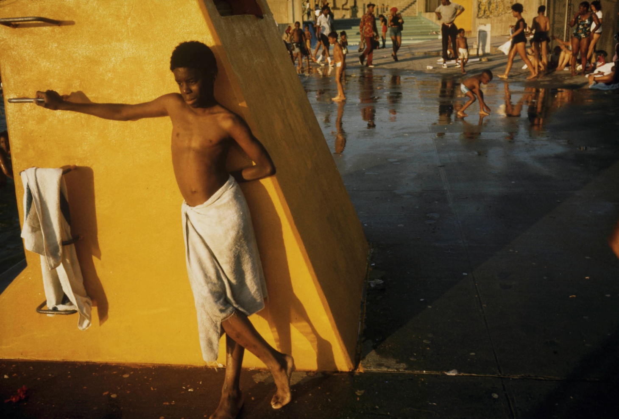
Informed consent
Notes:
Danny Lyon (1942– ),"Boy against a yellow platform at the Kosciusko Swimming Pool in the Bedford- Stuyvesant District of Brooklyn in New York City" New York, New York, July 1974. 1998 print from the original color slide. Records of the Environmental Protection Agency. (412-DA-13474) . NARA
Medical images of private living individuals are granted the highest level of privacy protections from both the federal government and many state laws. The only time this is not necessarily true is when the images have a model release form, or were taken of a federal worker during their expected work.
Model release forms signed by the individuals shown allow repositories to use images that might otherwise be restricted by privacy laws. Keep in mind however that there may be other laws restricting use, for example, nudes may run into problems with state obscenity laws unless used in a clearly scholarly context.
If Danny Lyon obtained a model release form, there are no privacy issues as long as this boy is old enough to sign such a permission (at least at the legal age of consent). If not, the photographer may be counting upon the fact that individuals photographed in public places have a lesser expectation of privacy. The photographer succeeds in avoiding trouble if he is not sued by these individuals or their parents when he uses these images. The photographer is particularly likely to loose the lawsuit if he titles the image something embarrassing, if he shoots the individuals where they have some expectation of privacy, such as in their living rooms, or if the images involve nudity.
Also okay if the repository has the copyright or there is no copyright. In cases where there is no model release and the image raises high levels of concerns (nudity, embarrassing, medical or psychiatric image, or taken in a place where privacy would be assumed) you should not release the image for viewing or use. If the repository lacks copyright, the image may be copied for research only in most repositories as long as the repository is not highly risk adverse. If there is nudity, particularly child nudity, this is a high risk situation and you may wish to restrict usage of the image.

Slide 90
Protected location information
Federal or State protected:
archeological sites
botanical, cultural patrimony, geological, or paleontological resources
caves or sacred places
endangered species nesting sites or habitats
wells & water sources
Notes:
WAVR’s collecting policy notes that some landscape images caption and a few images contain legally protected location information on federally or state protected locations of:
archeological sites, including those underwater
botanical, cultural patrimony, geological, or paleontological resources,
Legally recognized sacred places of the Wappo Indians of Napa Valley such as their burial places and dancing grounds,
endangered species nesting sites or habitat, and
Caves, wells and water sources.
WAVR withdraws these materials and provides copies without this information for access. When the information is found in the image itself (a rare case), the entire image is withdrawn, replaced with a withdrawal sheet noting it’s new secure location, and kept sequestered so it can’t be used for pillaging protected resources.
If this Adams image clearly indicated a sacred place of the Hualapai or Havasupai Indians in the Grand Canyon, particularly if specific geographic coordinates were given, it would need to have the specific location information screened and removed from the caption before being made available.
Ansel Adams(1902-1984), Grand Canyon from South Rim, 1941, Arizona. Vintage print. Records of the National Park Service. (79-AAF-8). Courtesy of the National Archives and Records Administration.

Slide 91
Accessing Native American photos
Native American Graves Protection and Repatriation Act, 1990
Protocols for Native American Archival Materials, 2006
Notes:
[Stairhall in John Alexander Logan home showing Native American pottery, baskets, textiles, and other items, Washington, D.C.], [between 1885 and 1900], published by Chas. S. Cudlip, LC P&P, Lot 9777, cph3c29068
NAGPRA: Native American Graves Protection and Repatriation Act (1990) protects sacred objects, burial grounds, ceremonies, human remains in archeological setting. Process to return cultural items to descendants.
Importance of consulting with tribal stakeholders/leaders/representatives
Protocols for Native American Archival Materials from 2006 meeting to identify best practices for cultrually responsive care and use of archival material held by non-tribal organizations.

Slide 92
Use restrictions
Donor imposed
Ethical considerations
Ownership issues
Legislation
Copyright
Publicity rights
Orphan works
Notes:
These laws restrict what you may do with an image, even though anyone may view the image at any time without legal issues. Usage means exhibition, publication, projection, and outreach.
Some Donor restrictions on use: Ownership issues, such as mystery collections found in your holdings or mystery collections being offered for sale. Lack of a clear deed of gift or legal title to a collection may lead to problems in some cases, for example, if the item was stolen from a federal or state government office, the federal or state archives can sue through the courts for the return of the item, this is called replevin. Publicity Legislation, which state law limits commercial usages of images of celebrities without permission of the celebrity or their estate. Not for the average citizen, celebrities like 3 Stooges, Elvis estate, others like Einstein are more likely to sue for damages over publicity rights, and Visual Artist’s moral rights, limit your ability to destroy, mis-attribute, or modify some limited edition fine art photos created since June 1991 during the photographer’s lifetime. For contemporary photographs in limited editions, signed & numbered. Be careful with captions & manipulation. Obscenity laws vary from state-to-state. Generally nude images of individuals, particularly children, that show their genitals are the highest risk images. If the image is in a strong cultural context, such as an artist's model shown in a studio, the level of risk recedes a bit. EX: Photo of Governor Arnold Schwartzenagger with the singer Madonna and Ice T. While it is possible that the governor would not enforce his commercial rights, the likelihood is that the other two performance artists would. So, to use the image commercially, you need to get permission. Ethical considerations like obscenity, nudity and other sensitivities.

Slide 93
Copyright
Limits right to:
Distribute copies
Modify or adapt work by using it to make new work
Publicly display more than one copy of work
Reproduce work
Transmit work through technological means
Glossary: A property right that protects the interests of authors or other creators of works in tangible media (or the individual or organization to whom copyright has been assigned) by giving them the ability to control the reproduction, publication, adaptation, exhibition, or performance of their works.
Notes:
Copyright is the most well known usage restriction and perhaps the most complex of all the restrictions largely because what began as a simple attempt in the U.S. Constitution to balance the rights of creators such as photographers to benefit from their work against the rights of society to adapt and creatively profit from this work to create new works has been modified and changed over the years by many new laws. Increasingly copyright is a battle ground between those who want share work, such as researchers, archives, libraries, museums, and consortia; and those who want to continue to benefit from a work made long ago, such as Film Studios, Software companies, Photographic Studios, and so forth. As always, when the battle is joined between potential creators and commercial interests, the commercial interests tend to win as they have deeper legal pockets.
Copyright is how the constitution strikes a balance between the creator’s rights to profit from his work, society’s need for creativity in the arts and sciences to make new works. The creator’s right to benefit from a work has a limited duration.
If the title transfer documents (deed of gift, sales document, deposit agreement or transfer agreement) don’t say that all copyrights are given, do not have them. If the title transfer documents say you received all copyrights you can’t necessarily assume that the donor actually had the copyrights unless the donor was the photographer or his or her direct heir. Many images are sold or acquired without copyright changing hands. Pay attention to copyright issues in deeds of gift and other title transfer documents.
To avoid copyright risks, posts notices on all copies provided and all copy machines indicating that the photographs being copied are for research only and that the researcher is responsible for obtaining copyright permissions. Also, make a good faith attempt to determine copyright status when they wish to publish, distribute, or use a work, placing a copy of their research in their files; analyze usages to determine if they are fair use; do not publish or grant researchers written permission to reproduce, distribute, perform, modify, or display photos for profit except when they hold a usage license, the copyrights, or other permissions; tell researchers in writing that it is their responsibility to obtain permissions from the copyright holder.

Slide 94
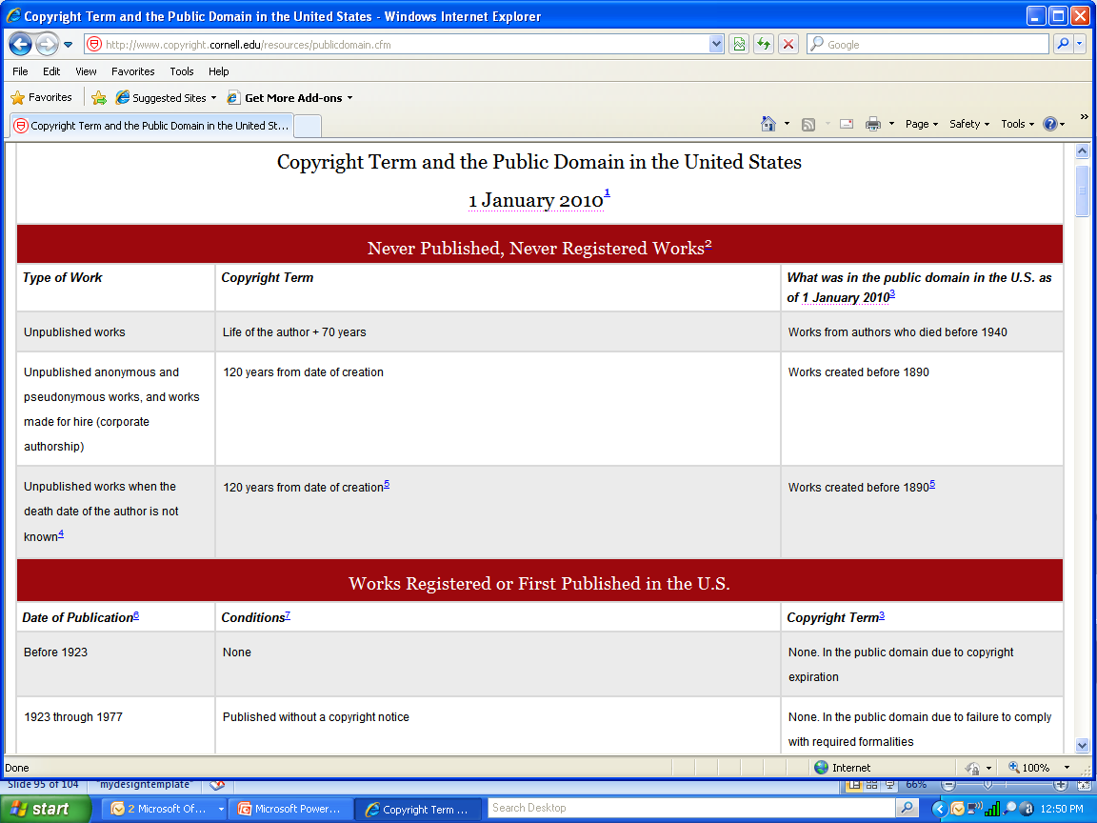
Notes:
Copyright chart from Peter Hirtle’s website (http://www.copyright.cornell.edu/training/Hirtle_Public_Domain.htm)
Contains information about unpublished and published works in the US, as well as outside of the US, regularly updated.
Unpublished works and works published in the U.S.; see PACM, chapter 10, p. 303 for chart
Practically speaking non-commercial transformative uses of a portion of an image that does not affect the market for the work are the least likely to have a problem. Before suing most copyright holders send out a “cease and desist” letter that gives WAVR one last chance to resolve the issue outside of the courts, by removing an item from a Website for example.
If you do not have a statement in the deed of gift granting you all copyrights, you probably do not have copyrights.
If you do not have copyrights, don’t grant permission to publish, sell, or adapt the image.
Indicate in your forms that the user is responsible for obtaining copyrights.
Mark copies as potentially being protected by copyright law.
Protected usages of copyrighted items include reproductions, distribution, performances, adaptations, and derivative works or displays including for profit PowerPoint usages.
Include information on LC Copyright Office and how to research registrations: http://www.copyright.gov/

Slide 95
Unrestricted use and exceptions
Public domain
Exceptions to restrictions
Fair use
Digital Millenium Copyright Act
TEACH Act
Notes:
“And then the fairies went to bed,” c1897 by Strohmeyer & Wyman, cph3b46578, Library of Congress Prints and Photographs Division.
More related to use than access.
Rights free: exceptions to copyright protection
Public Domain: unrestricted—not copyrighted or federally produced.
Fair Use: reasonable copying for teaching, private study, satire, reporting based on 1) purpose of use; 2) nature of work; 3) amount of work used; and 4) relationship to market. No copyright protection. Usually archivists use photos in their entirety. Disney video by Stanford.
TEACH Act: Technology, Education, and Copyright Harmonization Act, 2002: use of images for instruction especially in digital environment extending copyright law for accredited non-profit educational institutions to use in reasonable teaching.

Slide 96
Managing legal risks
Identify sources for help
Establish policies & procedures
Prepare a generic rights statement
Include copyright information with copies & on copy machines
Pay attention to warning labels

Slide 97
Think twice
Restrictions
Custody issues
Preservation needs
Duplicates & copies
Lack of captions
Incomplete group
Lack of sufficient resources
Notes:
Two children going through the “Dumps.” Location: [Rhode Island?], nclc04811, [1912 November?], Lewis Hine
Avoid acquiring: photos that need more research to be useful; out-of-scope, or lacking documentation, such as captions, logbooks, and provenance; copies and duplicates of originals currently available at other repositories; photos are in need of significant conservation treatment or health and safety issues; need for significant arrangement or research before they can be described; permanent donor restrictions or unclear legal ownership or copyright status; collections so large you must do sampling or weeding to take them; so costly that all other work must stop to accommodate them. Only take you have the resources to manage them effectively.
Photographs to acquire: Relevant to mission; Fills gaps; Depth of subject matter; Accurate documentation; Donations funding processing; Original images; Original order intact; Clear arrangement. Acquisitions need to support mission, collecting policy, subject focus and users, have valuable informational content, strong artifactual or associational characteristics, strong evidence (e.g. record) of actions
First and foremost photographs attract users. In the last 15 years photographs have finally come into their own as they are being effectively used in articles, books, during video history interviews, in exhibits, films, in CDs, and on the Web. Photographs have information on many levels, plus the ability to transport the human into the past in an almost physical way. Photographs record information and evidence that no other media can—the everyday look and feel of the past.
Most places try to collect photo collections, rather than individual items, partial series, or file with a complete provenance and chain of custody (history of ownership); captions that are accurate, complete, and reliable; good condition, reasonable quantity, and low preservation costs; good depth of subject matter; relevance to your repository’s topical focus, that can fill gaps in your repository holdings; with copyright transfers and model release forms, requiring little legal research; high percentages of relevant photographs to the repository’s mission; donations of resources to help fund their processing
Tell donors that if they receive funding with the donation, the processing and preservation will be done speedily. Have a bequest program, that helps individuals who want to will money.
Look for collections with enough images to make it possible to do comparisons over time, across space, or throughout topics; a high proportion of unique first generation photos, not copies or dupes of what someone else has. Avoid accepting split series or partial collections when possible; original order, requiring significant processing, and clear arrangement.

Slide 98
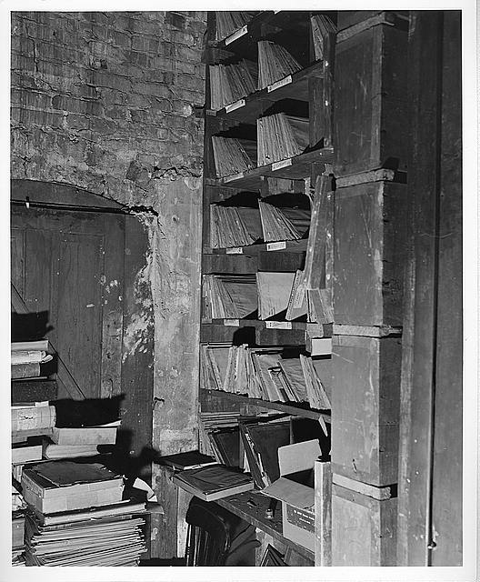
Hands-On Learning Activity
Notes:
Interior of L.C. Handy Studio, 494 Maryland Ave., SW, Washington, D.C., with glass negatives dating back to Mathew Brady in wood cubby holes next to crumbling brick wall] / photograph by the Library of Congress. 1954 Aug. 6. http://hdl.loc.gov/loc.pnp/ppmsca.03436
We are going to score a potential accession being offered to WAVR to get a rating on its value for acquisition:
Break into groups of six
Read the first collection’s description
Read the definitions of value, use, and risk
Assign a ranking to the materials for each category
Fill in the ranking and rating form for the collection
Repeat for the second and third collection
Get ready to report back to the group which collections you feel WAVR should add to their holdings and why

Slide 99
Appraisal Case Study
Western American Vintner’s Repository (WAVR)
Proposed Accession: The Handly Photographic Studio
Notes:
Bakersfield. A cottage home, Black Hamburgs, [1888], Carleton E. Watkins, LC P&P, cph3b44431
[Interior of L.C. Handy Studio, 494 Maryland Ave., SW, Washington, D.C., with glass negatives dating back to Mathew Brady in crumbling jackets stored in wood cubby holes] / photograph by the Library of Congress, [1954 Aug. 6.], LC P&P, ppmsca03440 DELETED
Generally when it rains, it pours. Acquisitions have dry spells and times of high flood. You need to plan your appraisal activities to help even out the workload and manage it effectively.What do you need to know before your start trying to appraise this photo studio?
WAVR’s records schedule, collecting plan, documentation strategy, or at least the holes in your holdings, as well as your topical and thematic focus,
What is being offered to you in terms of holdings, collections and series, quantities, formats and media, dates of the materials, and what they cover
Resources in terms of space, staffing, funding, photographic expertise, and rapid response capability. If you take in more than you can effectively manage, this is a risk.
Other potential risks the materials may pose to your staff, users, and repository holdings, in terms of conservation, legal and ethical issues,
What values they may have to your repository’s users, staff, and other stakeholders, and mission.
If you remember nothing else today, keep in mind the three key concepts of values, uses, and risks and how to analyze them.
Appraisal Form for Photographic Materials from National Park Service, Museum Management Program, PACM, p. 122, Appendix 4-C. Form is used in the WAVR appraisal of 3 series.

Slide 100
Series I
WAVR Repository Events Series (negatives)
Notes:
20th annual convention of the Special Libraries Ass’n, May 21-23rd, Wash. D.C., 1928, 1928 May, Rideout, pan6a25290, LC P&P.
An image that might be in the series Western American Vintner’s Repository Events if we pretend that it was taken during SLA’s meeting in Zinfadel, California and photographed by Handly.

Slide 101
Series II
Zinfadel Valley Portrait Series
(negatives and contact prints)
Notes:
Grapes grown in Kern County, California, LC-USF34-009926-E, 1936 Nov., Dorothea Lange, FSA-OWI, LC P&P, fsa8b29886.
A representative example of a portrait from Series II, Zinfadel Valley Portrait Series if we pretend it was taken by Handly of a Zinfadel local.

Slide 102
Series III
Zinfadel Valley Journal Morgue Series
(negatives and prints)
Notes:
Sonoma County, California. Bottling wine and corking bottles of wine…, LC-USF34-071458-D, 1942 Jan., Russell Lee, FSA-OWI, LC P&P, fsa8c23604
A representative example of a photo from Series III, Zinfadel Valley Journal Morgue Series if we pretend it was taken by Handly at a Zinfadel area bottling company.

Slide 103
Scoring
High =5
Moderate = 3
Low = 1
None= 0
Score=25 or less
(value + use) – risk = ranking
Notes:
For Usage Ratings:
Compare the collection to the mission statement or collecting policy. Give it a high, medium or low depending on how well it matches.
part of the appraisal committee's role to decide what to weight. If budget is driving everything, you will focus on risks and use rather than weighting value more heavily.....
Sonoma County, California. Corks for wine bottles in winery, LC-USF34-071471-D, 1942 Jan. Russell Lee, FSA-OWI, LC P&P, fsa 8c23617
A representative example of a photo from Series III, Zinfadel Valley Journal Morgue Series if we pretend it was taken by a wire service (like Black Star) at a Zinfadel area bottling company.

